Slide 1
Riparian Forest Buffers
Prepared by Tracey Cohen, AKRF
Notes:
Welcome to this Green Infrastructure Maintenance Training. This presentation is one of several in the training series.
You can view the entire series sequentially or each module independently.

Slide 2
Overview
What Is a Riparian Forest Buffer
What are Benefits of Riparian Buffers
Why Is Loss of Riparian Buffers a Problem
How Can We Restore and Maintain Riparian Buffers
Photo source: htt p://www.dcnr.state.pa.us/cs/groups/public/documents/document/dcnr_20031767.jpg
Notes:
For a variety of reasons, our natural landscapes have lost much of the vegetation that had protected our streams. To restore the buffers requires some forethought.
In this presentation you will learn:
What Is a Riparian Forest Buffer?
The Benefits of Riparian Buffers
Loss of Riparian Buffers
Restoring and Maintaining Riparian Buffers

Slide 3
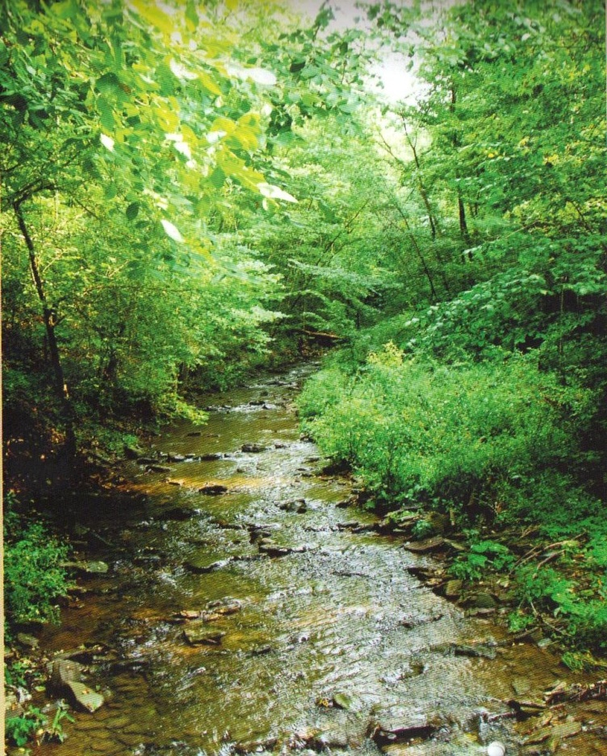
What Is a Riparian Forest Buffer?
Photo Source: PA DEP Bureau of Watershed Management, Riparian Forest Buffer Guidance. November, 2010.
Notes:
A riparian forest buffer is forested land located along a river, stream, lake, pond, or wetland.

Slide 4
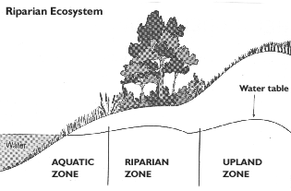
What Is a Riparian Forest Buffer?
Notes:
Riparian forest buffers are found between the water’s edge and the beginning of drier upland. This transition zone, which is known as the riparian zone, usually experiences recurring flooding and high groundwater levels.

Slide 5
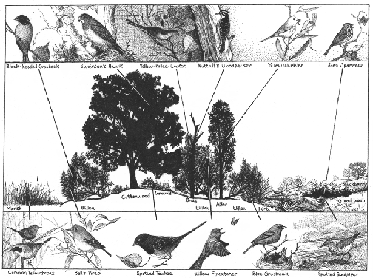
The Benefits of Riparian Buffers
Habitat
Source: http://www.pointblue.org/our-science-and-services/conservation-science/bays-wetlands-rivers/cv-rivers
Notes:
A healthy riparian forest has an overstory or canopy layer of tall mature trees, an understory layer of smaller trees, a sapling-shrub layer of young trees and shrubs, and a low layer of groundcover, which includes herbaceous plants such as wildflowers, ferns, and grasses, as well as woody plant seedlings. These layers provide diverse feeding and nesting locations for a variety of birds and other wildlife.

Slide 6
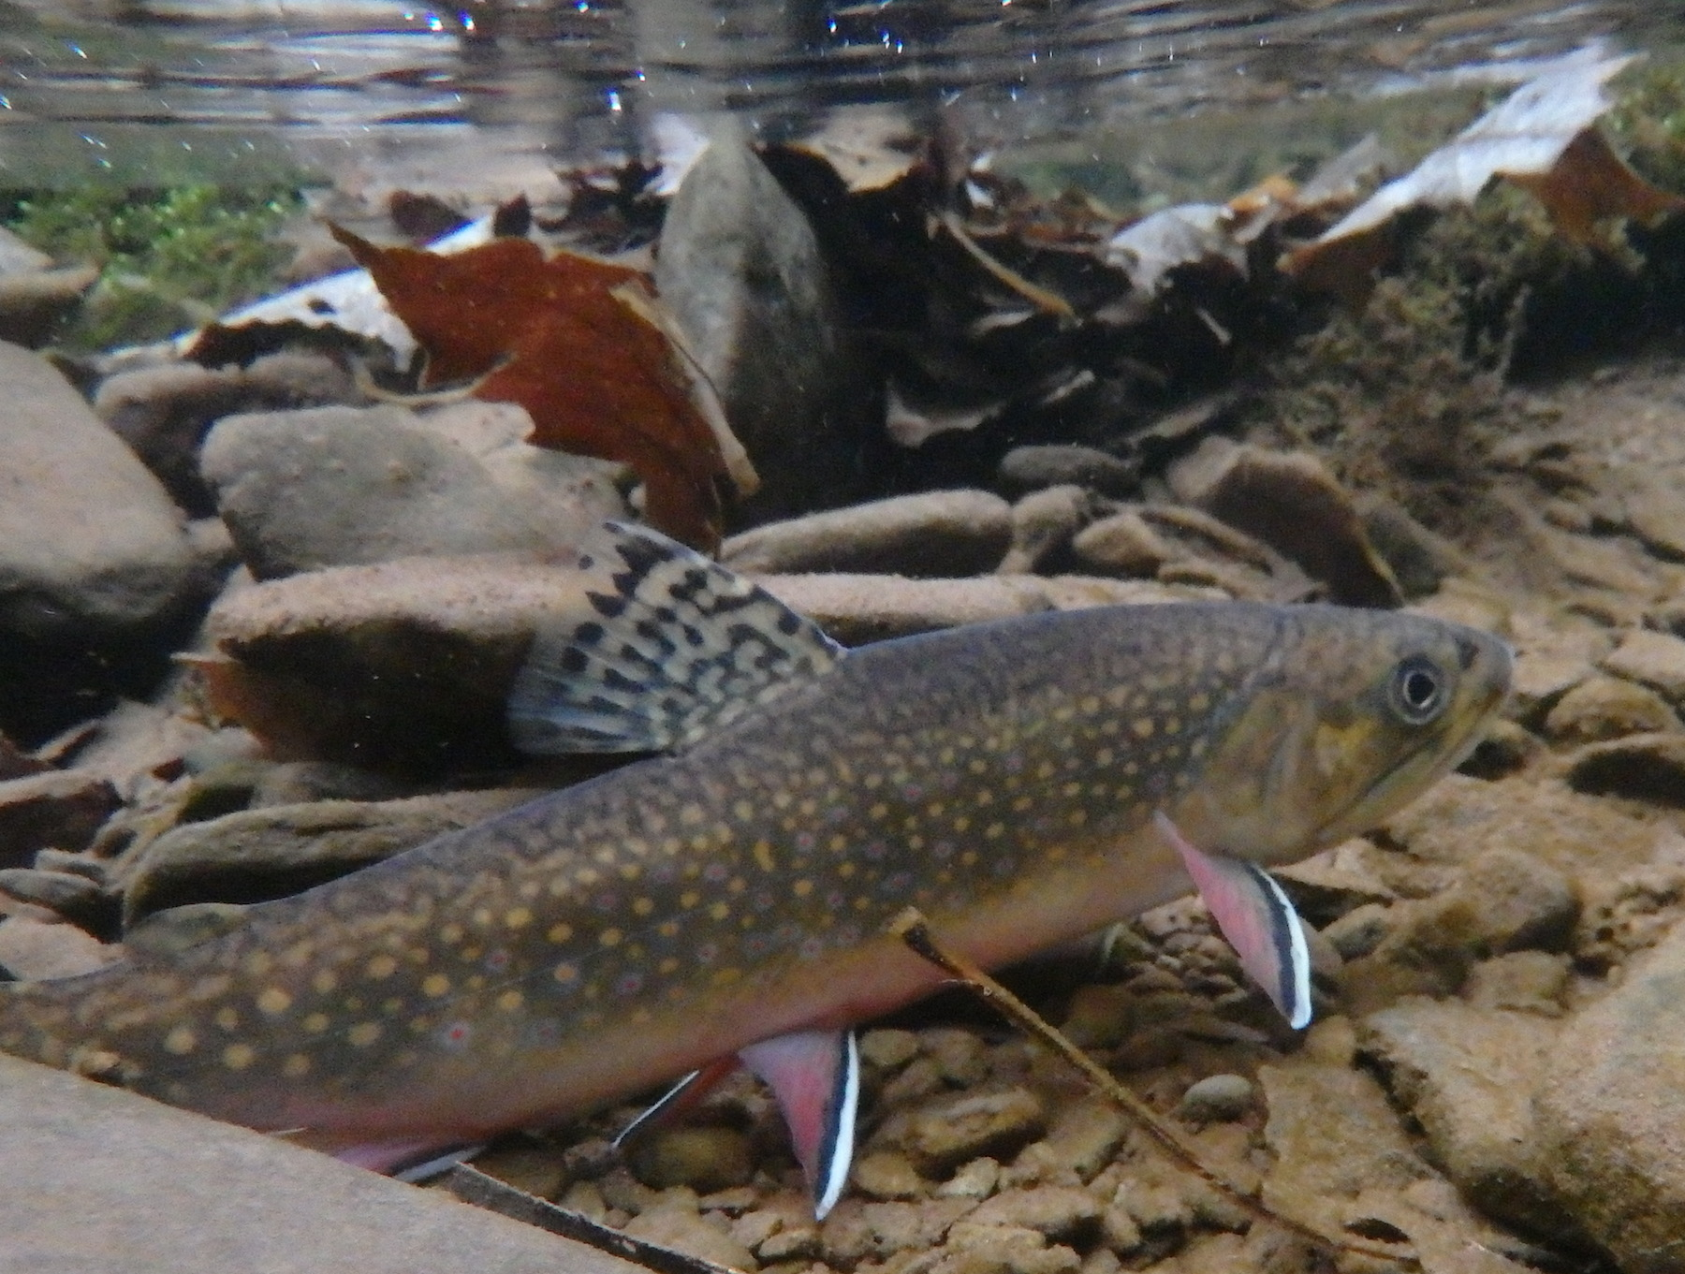
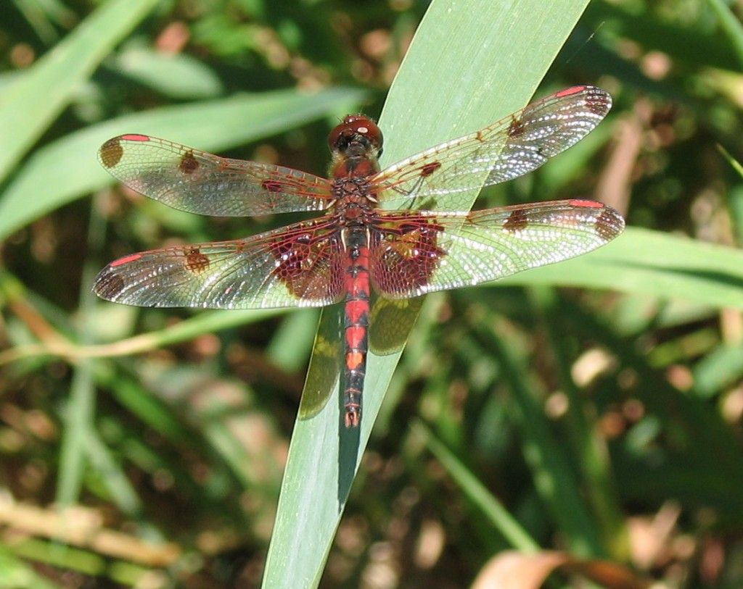
The Benefits of Riparian Buffers
Habitat
Photo Source: http://www.tu.org/sites/default/files/project_profile/PB170113%20copy.JPG
Photo Source: http://www.nepaaudubon.org/wp-content/uploads/2014/08/Calico-Pennant-male-Monroe-Co-PA-1024x813.jpg
Notes:
Riparian forest buffers help maintain high-quality, in-stream aquatic habitat for invertebrates, fish and other wildlife in several ways.
Leaves and woody debris that fall in the water from streambank vegetation provide organic matter that is food for aquatic invertebrates. In turn, these invertebrates are food for fish and other wildlife.
Plant debris also provides structure that aquatic animals use for cover.
Overhanging trees along the riparian zone create shade that keeps the water cool and helps maintain adequate dissolved oxygen in the stream. Without a forest buffer, fish species and invertebrates that need cool, oxygen-rich water will be replaced by species more tolerant of degraded conditions.
In addition to providing food and cover, riparian buffers are important corridors that connect larger habitat areas and allow a variety of wildlife to move across urbanized landscapes.

Slide 7
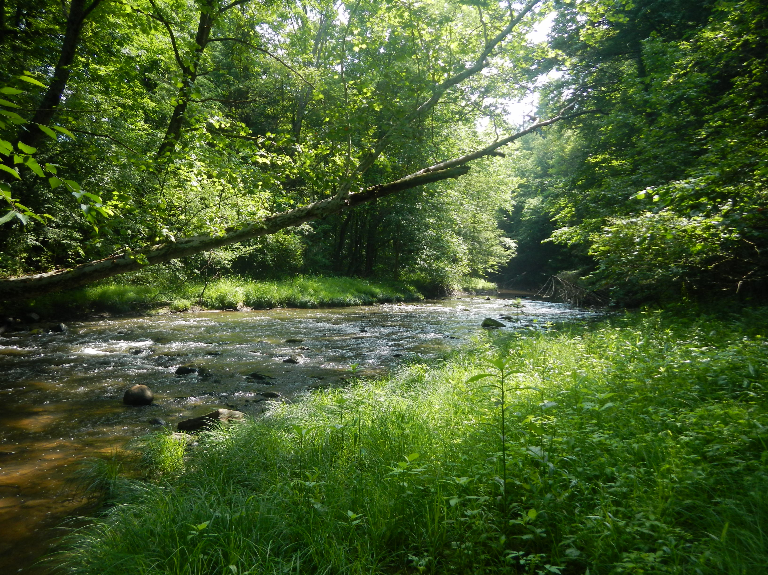
The Benefits of Riparian Buffers
Water Quality
Photo Source: http://sites.allegheny.edu/creekconnections/riparian-buffers/
Notes:
Buffers perform several important functions that improve the water quality in streams.
The roots of plants, such as the grasses along the streambank shown here, hold soil together, and protect streambanks and shorelines from erosion due to floods and runoff. This keeps sediment, which can clog the gills of aquatic animals and smother their spawning sites, out of the stream.
Vegetation creates a rough surface that slows stormwater runoff and allows it to soak into the soil and recharge groundwater.
As runoff slows, it also drops sediment that it is carrying, allowing this material to accumulate in the riparian zone where it helps to build stream banks.
Other pollutants carried by stormwater runoff, such nitrogen and phosphorus, and chemical pesticides, are also intercepted by buffer plants.
And nutrients and other pollutants in shallow, subsurface water flow are also trapped by the roots of riparian plants.

Slide 8
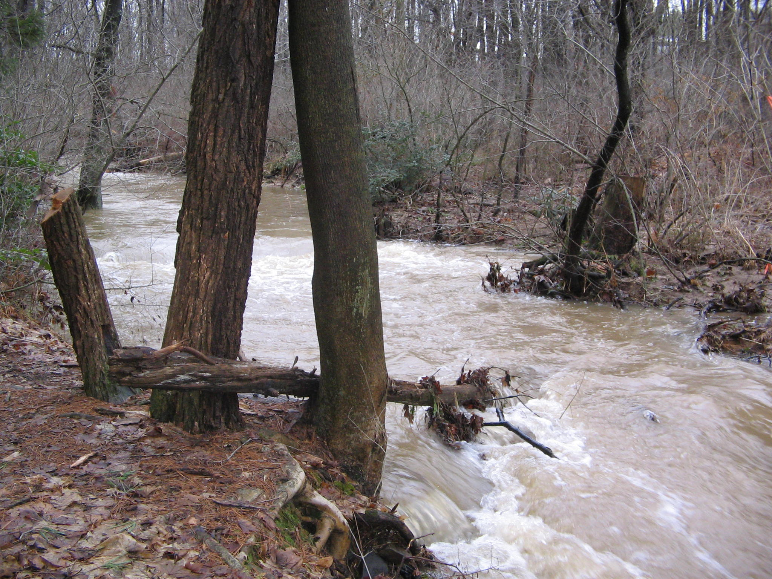
The Benefits of Buffers
Flood Protection
Photo Source: http://www.mrsoshouse.com/enviro02/photo2.html
Notes:
Riparian vegetation provides flood protection by slowing floodwaters when they overtop streambanks during or after major storms.

Slide 9
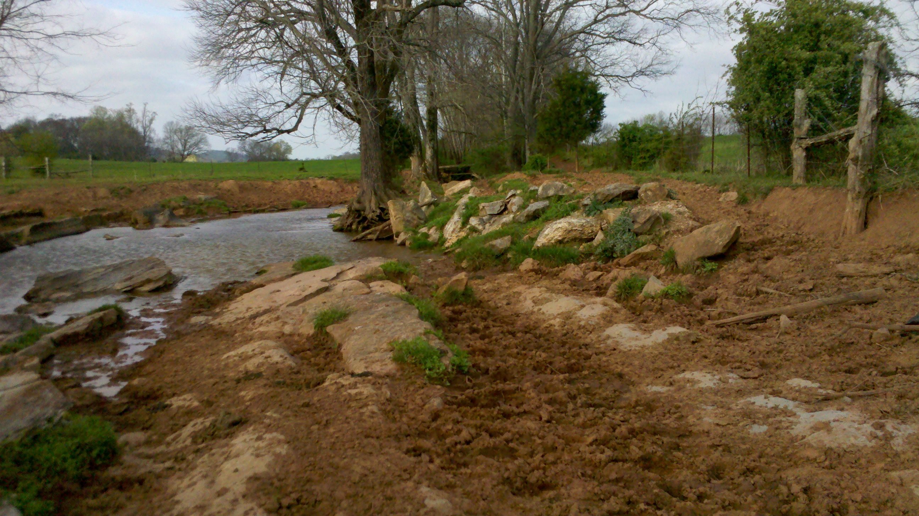
Loss of Riparian Buffers
Photo Source: https://ag.tennessee.edu/watersheds/Documents/buffer4.jpg
Notes:
Many riparian forests have been severely damaged or even removed completely by real estate development, agriculture, and other human activities. The loss of buffers negatively affects wildlife habitat and water quality.
In this photo, cattle have trampled the streambanks and destroyed the vegetation; consequently, there is inadequate buffer on both sides of the stream, and the benefits of the buffer such as wildlife habitat and water quality have been lost. Fortunately, it is possible to restore the structure and function of riparian buffers.

Slide 10
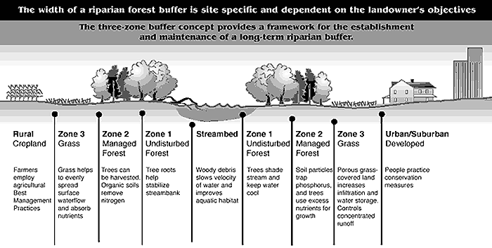
Restoring Riparian Buffers
The Three-Zone Concept
Source: University of Maryland Fact Sheet 725 - Riparian Forest Buffer Design, Establishment, and Maintenance
Notes:
Riparian restoration is often based on a three-zone conceptual model of a riparian buffer. For each zone, the types of trees, shrubs, and herbaceous plants can vary depending on site characteristics and the benefits or functions desired.
Zone 1 is immediately adjacent to the stream. This zone protects the bank from erosion and provides shade and organic materials to the stream, as well as wildlife habitat. Species that tolerate wet conditions should be planted in this zone.
Zone 2 is the middle zone; it provides habitat and protects water quality by slowing down runoff and trapping sediment and nutrients such as nitrogen and phosphorus before they can enter the stream. This zone may be a managed forest or mixed forest and shrubland.
Zone 3 is the outer zone and is the first zone to intercept surface runoff coming from outside the riparian buffer. This zone is especially important for slowing runoff and trapping the large amounts of sediment and pollutants from agricultural operations or urban streets. A mix of grasses and wildflowers, which are effective in intercepting runoff, are typically planted here. In residential settings, this zone may be a yard or garden planted with meadow grasses, a shrub border, or light woods.

Slide 11
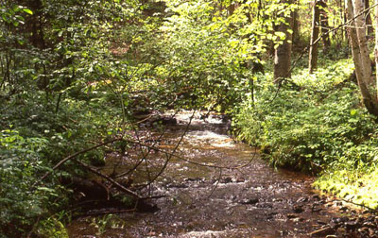
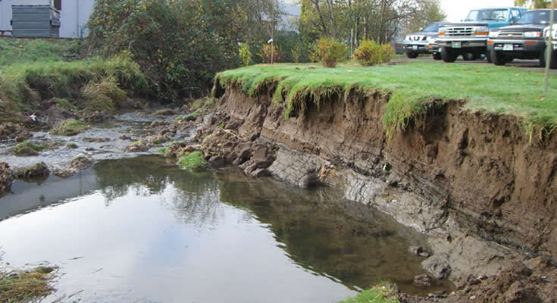
Restoring Riparian Buffers
Site Assessment
Notes:
The first step in designing a riparian buffer is to determine the existing conditions on the site.
A site assessment should include the following questions:
Is there an existing buffer?
Is it healthy?
What plants are growing there?
Are there invasive species?
How much area has been invaded?
Is there evidence of deer browse?
Is the streambank intact or eroded and needing repair?
What other problems need to be addressed before any planting can take place?
For example, the photo on the left shows a riparian buffer with well developed vegetation. A site assessment would identify the plant species present and determine whether there are non-native invasive species. The photo on the right shows a stream with no buffer that is experiencing severe erosion. The buffer zone is occupied by parking and turf grass. This site requires extensive work to restore the stream banks and create a riparian plant community.

Slide 12
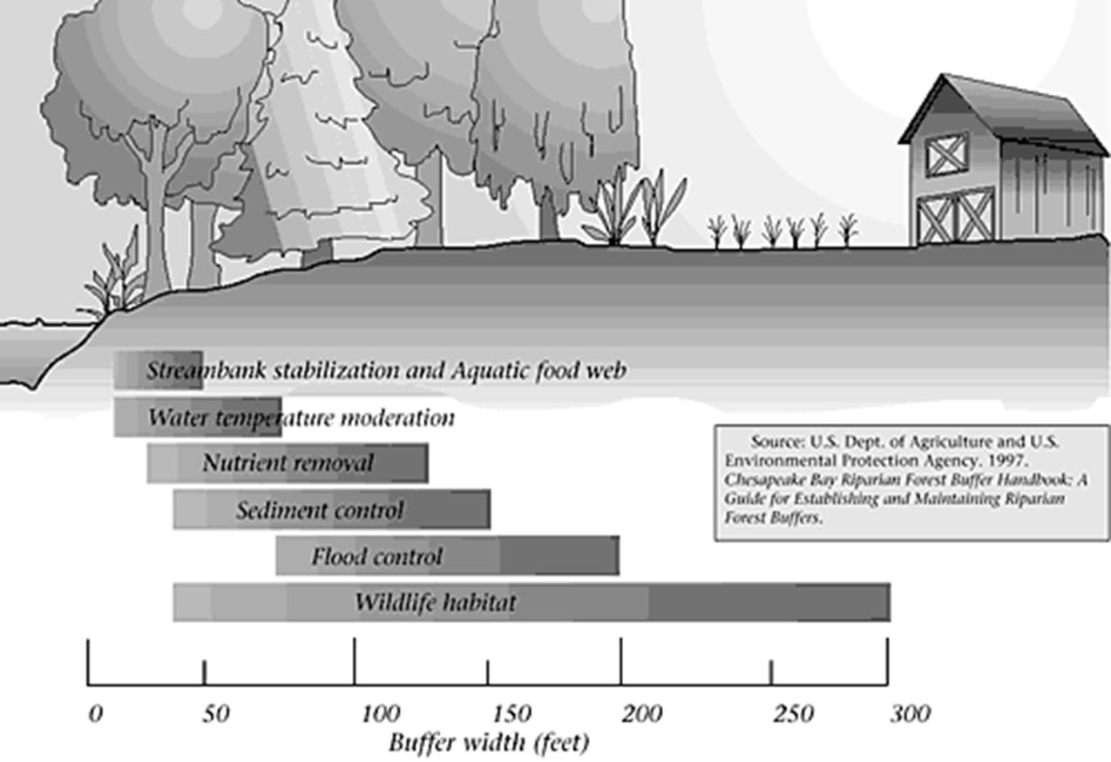
Restoring Riparian Buffers
Buffer Width
Notes:
To determine the ideal width of the buffer, the intended functions should be identified. For example, if the primary function of the buffer is streambank stabilization, a buffer 50’ wide may be sufficient. To remove nutrients from runoff, over 100’ wide is more effective. In general, wider buffers provide more benefits than narrow buffers.
The width of the buffer or individual buffer zones also depends on site characteristics such as slope of the land. Where the riparian area has a very steep slope leading to the water, a wider buffer is needed to slow stormwater runoff.

Slide 13
Restoring Riparian Buffers
Buffer Width
SPECIES
Wildlife Dependent on Wetlands/Waterways
Bald eagle, nesting heron, cavity-nesting ducks
Pileated woodpecker
Beaver, dabbling ducks, mink
Amphibians and reptiles
Belted kingfisher
Songbirds
Scarlet tanager
Hairy woodpecker
Blue jay, black-capped chickadee
Cardinal
Cold-Water Fisheries
Desired Width (in feet)
30-600
600
450
300
100-300
100-200
40-660
660
130
50
40
100-300
Notes:
If providing wildlife habitat is a main goal, the buffer will need to be much wider than a riparian forest buffer focused primarily on improving water quality. In general, 300’ is the minimum width recommended for maximum wildlife value, but that depends on how much land is actually available and what the property owner wants to do.

Slide 14
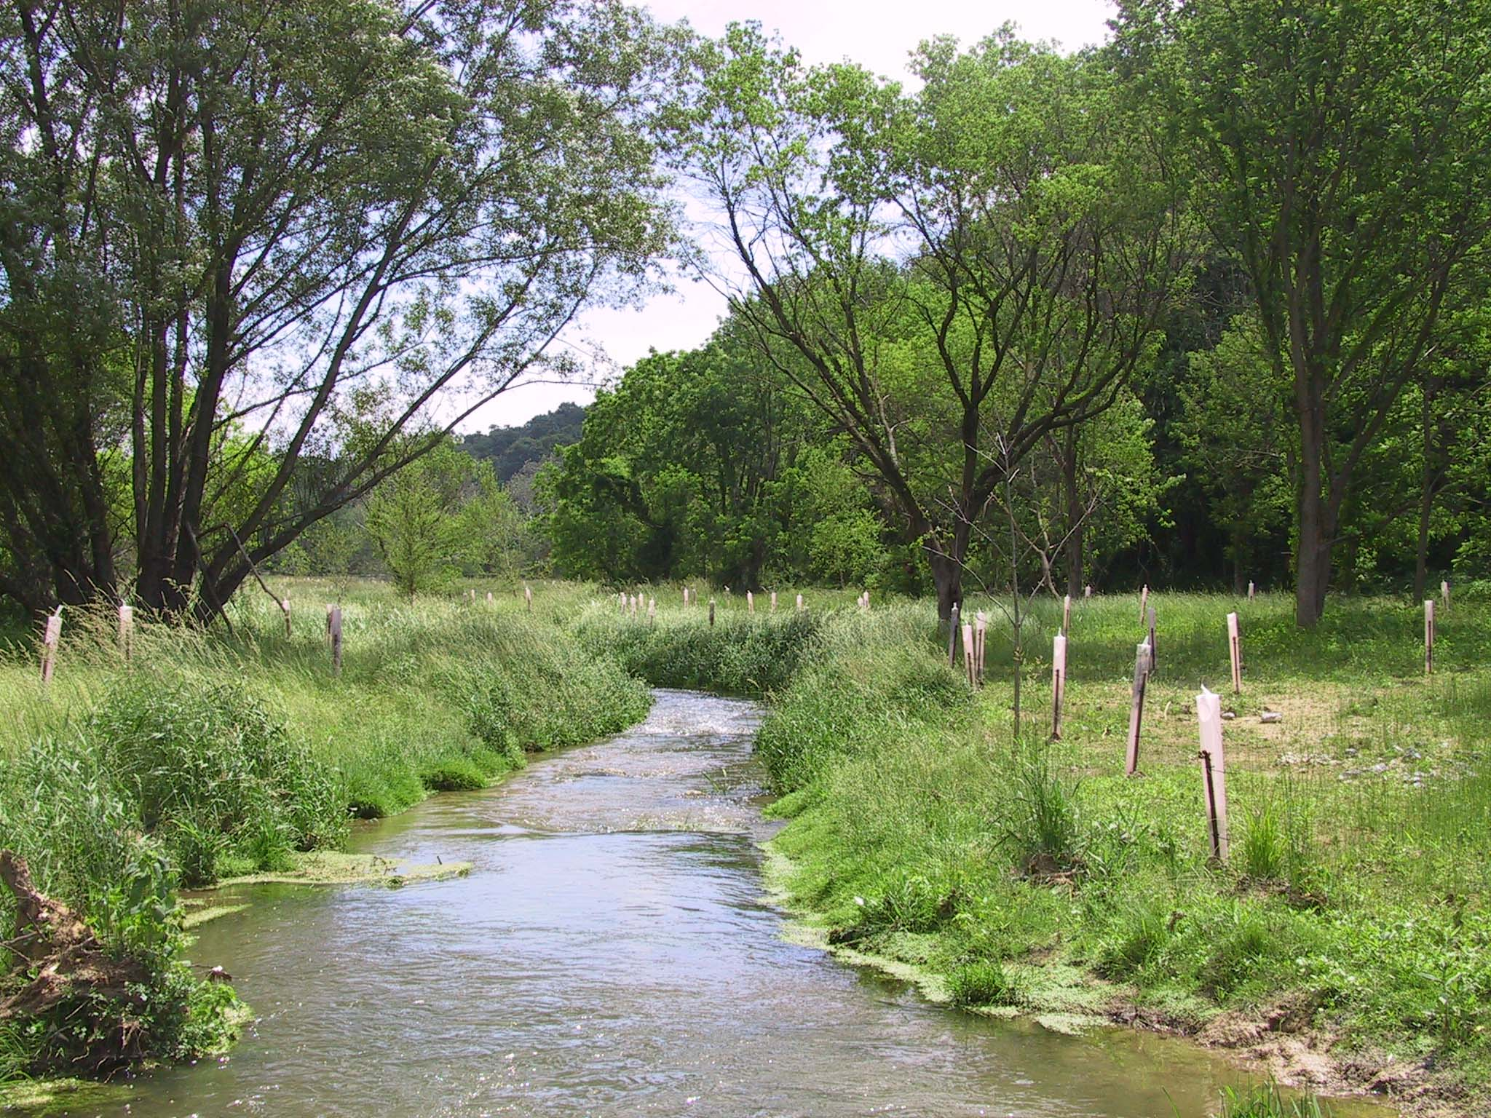
Restoring Riparian Buffers
Choosing Plants
Photo Source: https://allianceforthebay.org/wp-content/uploads/2014/05/New-buffer-on-Lititz-Cr-Floodplain.jpg
Notes:
When designing riparian buffers, choose native species adapted to the specific site conditions, that is, the particular combination of sun and shade, moisture, flooding and soil pH.
In general, plants should
tolerate or depend on available moisture during the growing season.
tolerate periodic flooding as well as dry periods due to drought or low water table.
regenerate naturally so that they don’t require constant attention.

Slide 15
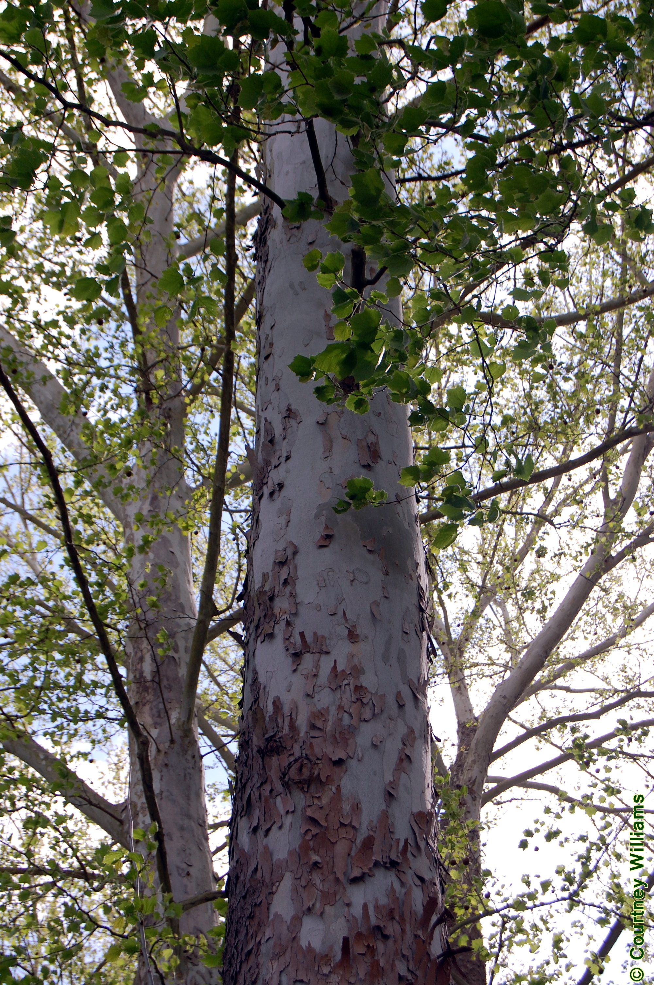
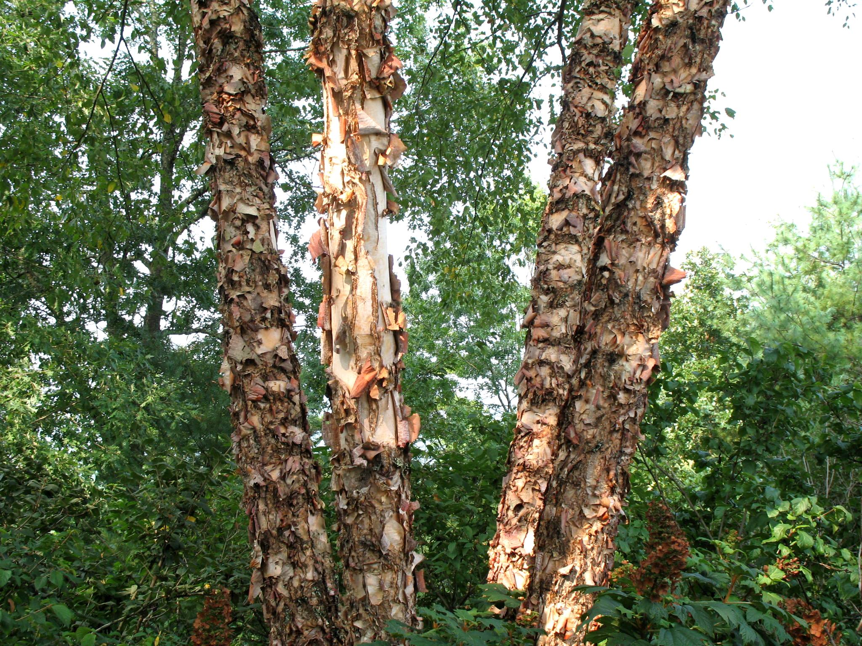
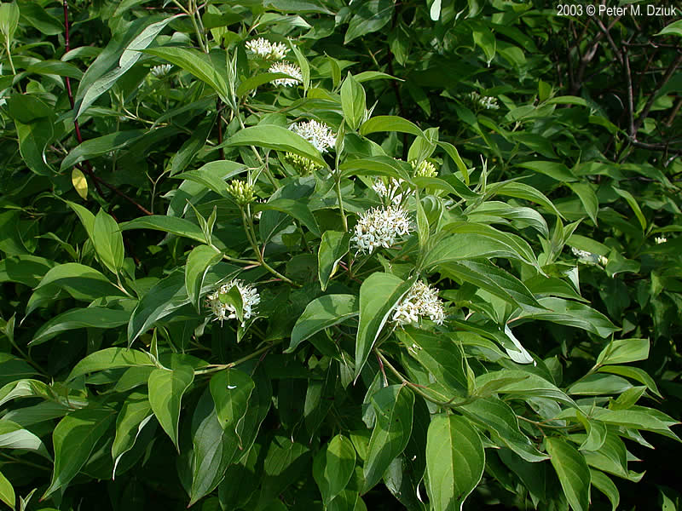
Restoring Riparian Buffers
Choosing Plants
River Birch (Betula nigra)
Photo Source: ttp://www.onlineplantguide.com/Image%20Library/B/1687.jpg
American Sycamore (Platanus occidentalis)
Photo Source: http://forestry.sfasu.edu/faculty/stovall/dendrology/index.php/fact-sheets-sp-916/photographs/124-platanus-occidentalis-american-sycamore
From PWD Tipsheet # 3, Backyard Buffer Program
Silky Dogwood (Cornus amomum)
Photo Source: https://www.minnesotawildflowers.info/shrub/silky-dogwood
Notes:
Choose species that are typical of native plants communities found locally. Species native to the area are more likely to establish and grow with less need for maintenance and water.
There are many online sources of information to determine suitable native plants. This partial list is from a factsheet produced by the Philadelphia Water Department Office of Watersheds. Other municipal, state, and federal agencies, as well as conservation organizations, provide free resources to help with restoration projects.

Slide 16
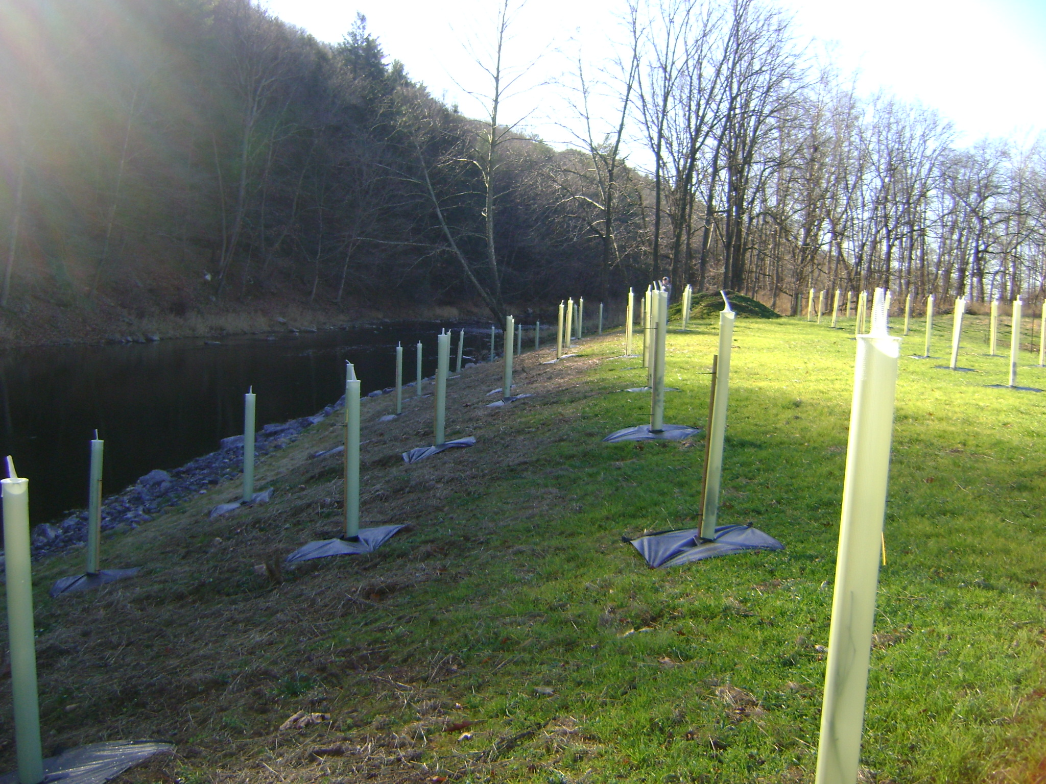
Restoring Riparian Buffers
Plan for Growth and Change
Photo Source: http://www.wvchesapeakebay.us/images/resources/buffer.JPG
Notes:
Plan for changes in plant communities over time:
On a site with no tree canopy, as shown here, choose sun tolerant species for the early establishment period.
Add shade tolerant species later to support plant community development when the tree canopy fills out.

Slide 17
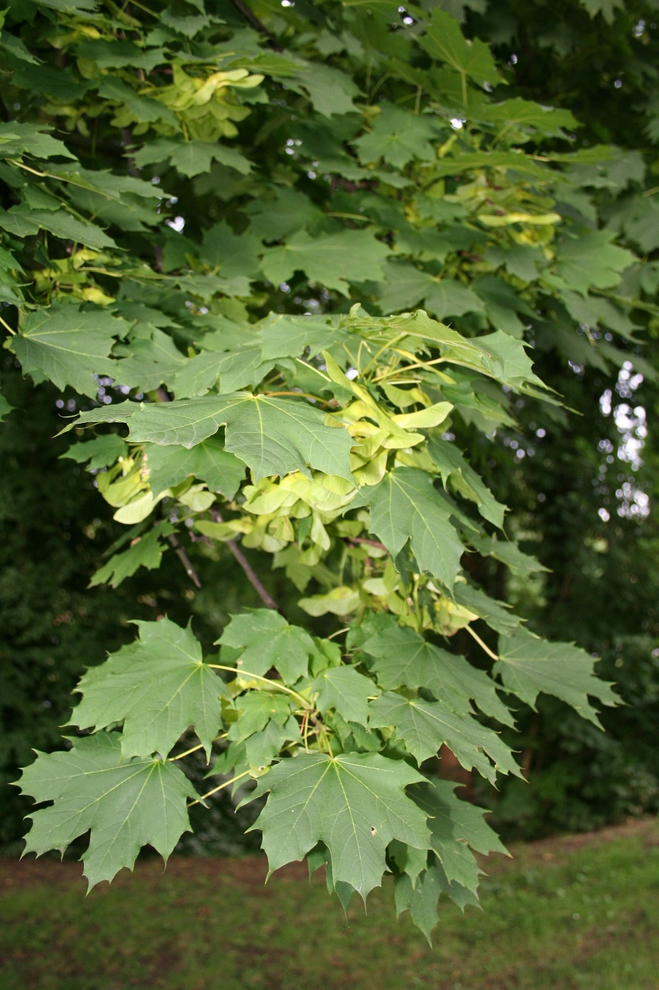
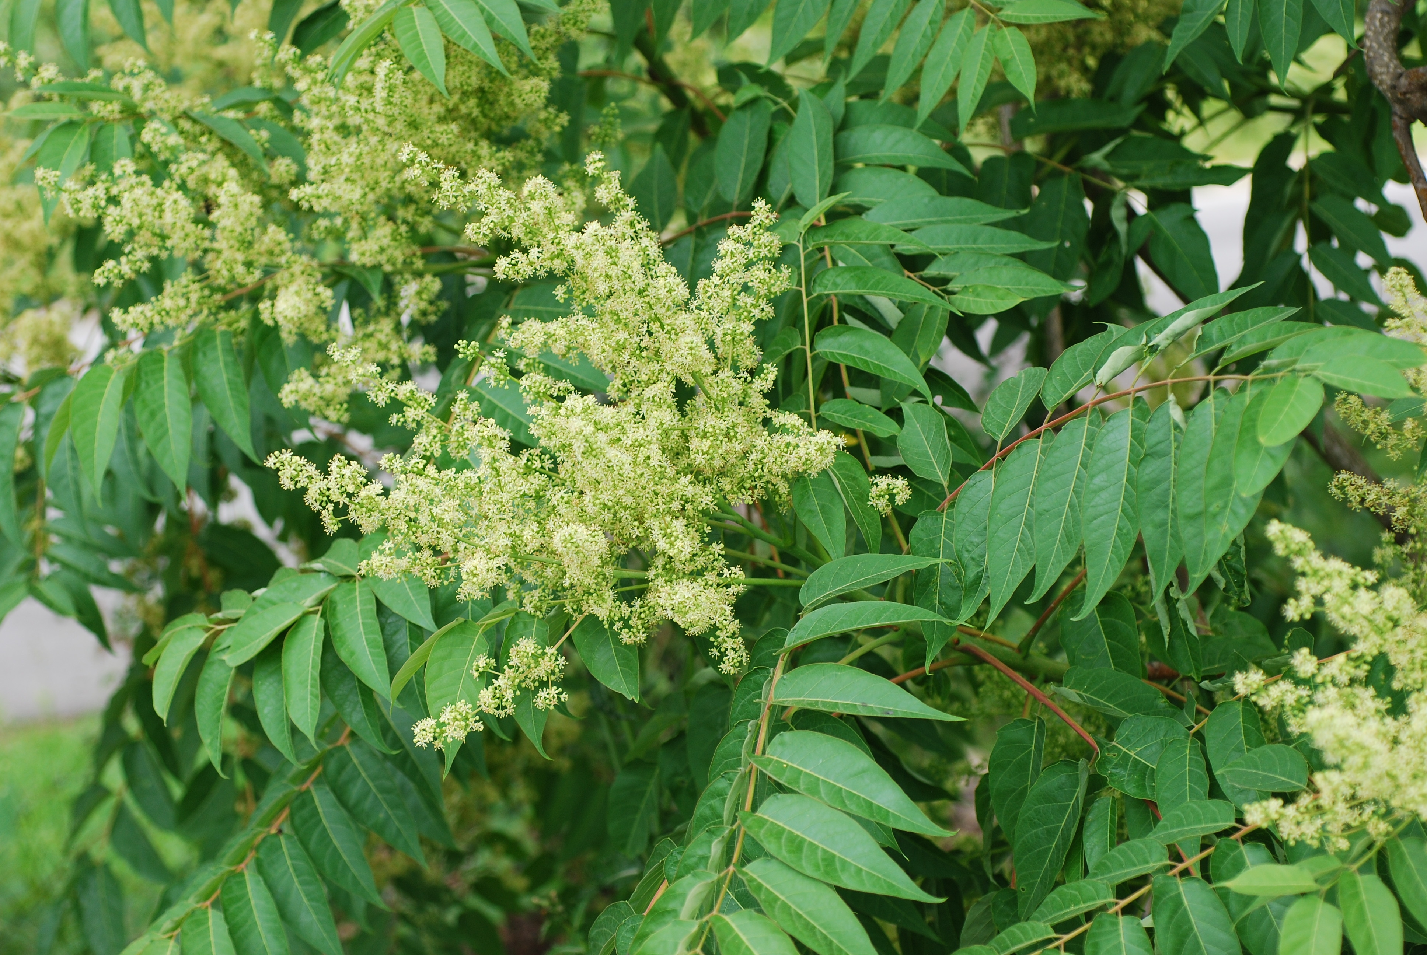
Restoring Riparian Buffers
Site Preparation
Invasive Trees
Tree-of-Heaven (Ailanthus altissima)
Photo Source: Doug Goldman, hosted by the USDA-NRCS PLANTS Database
Norway Maple (Acer platanoides)
Photo Source: https://upload.wikimedia.org/wikipedia/commons/b/bc/Acer_platanoides_1aJPG.jpg
Notes:
To prepare a site for restoration, it is essential to minimize competition to allow new plants to become established.
Most importantly, invasive species must be controlled, and as much as possible, eliminated. There are a number of invasive species such as Norway maple and Tree of Heaven that are commonly found in riparian areas that spread aggressively and displace native species.

Slide 18
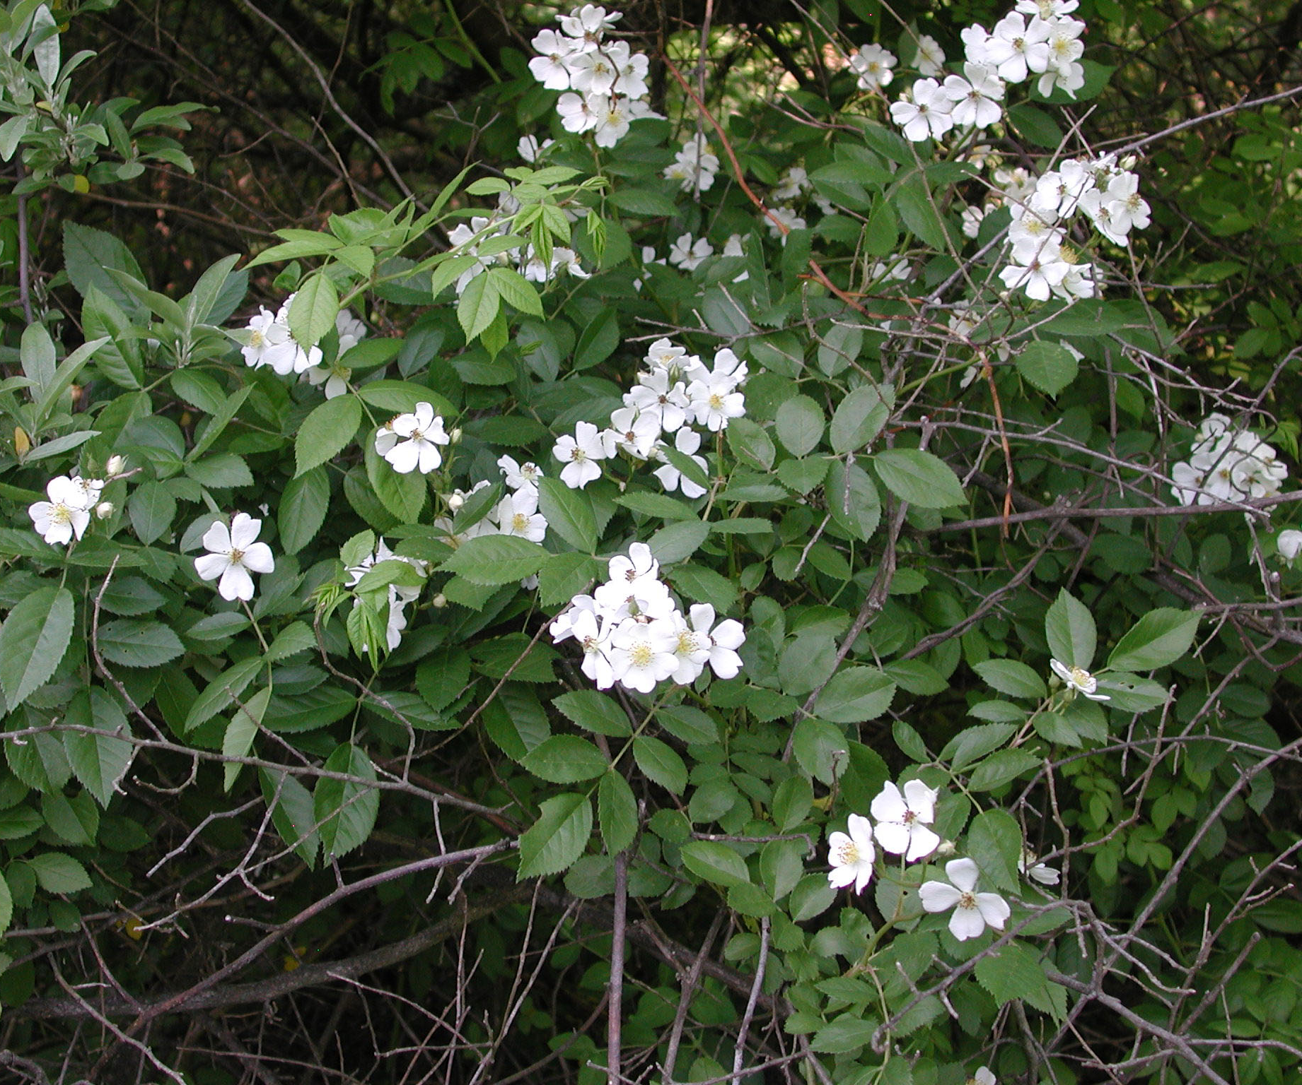
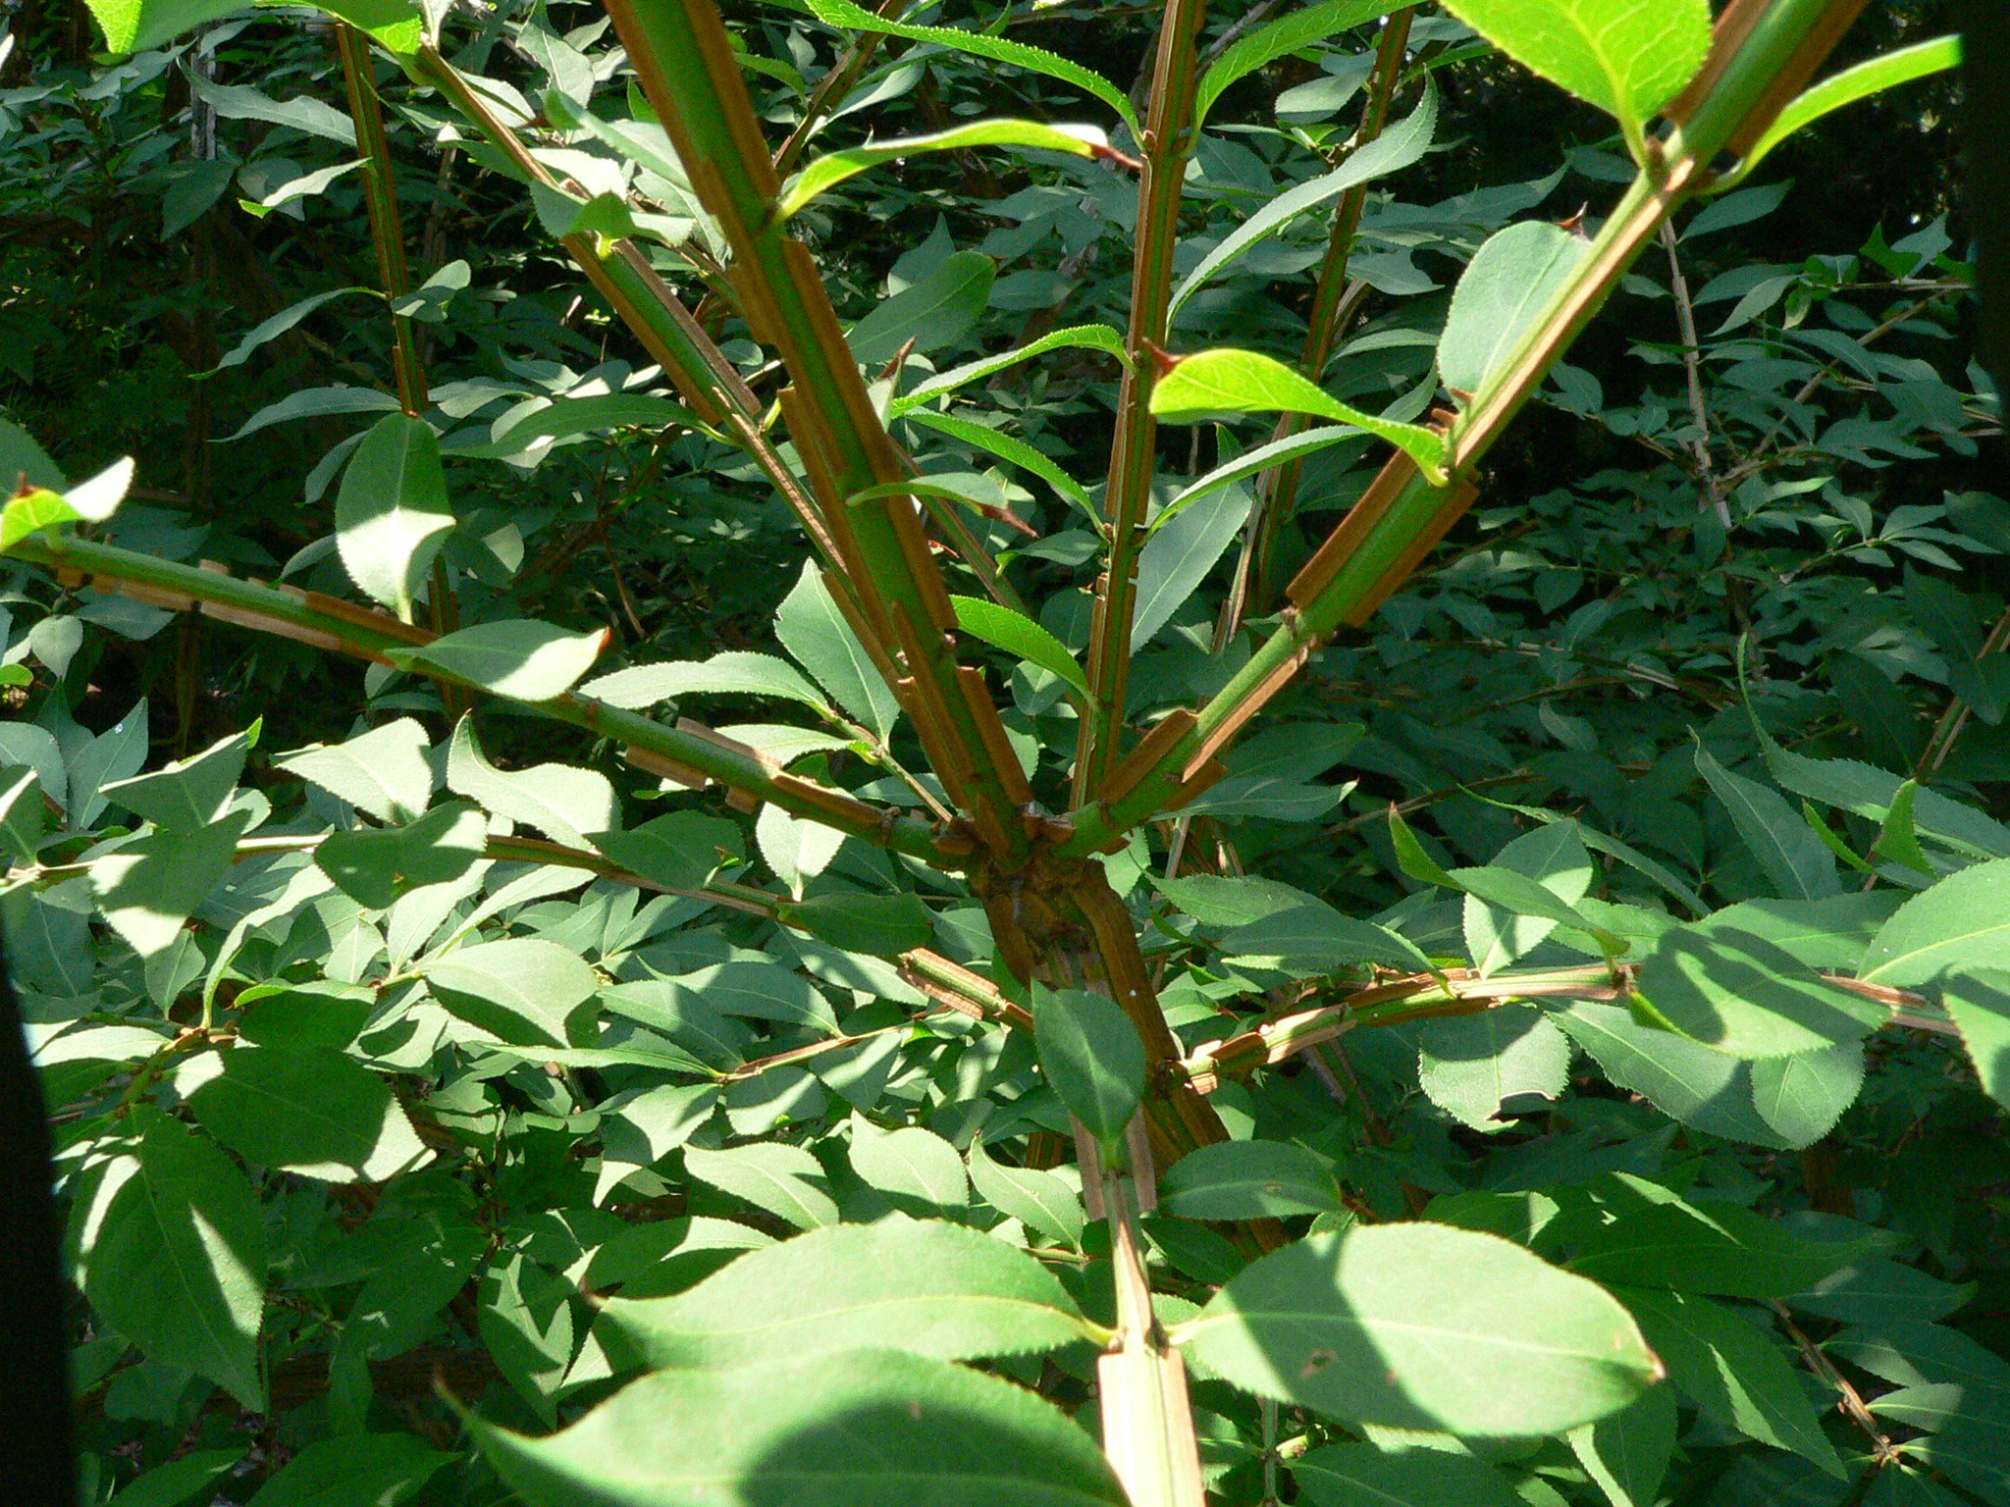
Restoring Riparian Buffers
Site Preparation
Invasive Shrubs
Multiflora Rose (Rosa multiflora)
Burning Bush(Euonymus alata)
Photo Source: http://www.athensconservancy.org/invasives/jk-rosa_multiflora6.jpg
Photo Source: http://www.extension.umn.edu/garden/yard-garden/trees-shrubs/burning-bush/img/wings.jpg
Notes:
Different invasive species often require different control methods, e.g., hand pulling, mowing or string trimming, and herbicide application. Sometimes multiple methods are needed. Invasive species control may also require more than one growing season before desired buffer plants can be installed.
For example, small infestations of multiflora rose (shown on the left) can be controlled by cutting the top growth and pulling out the entire root before the plant goes to seed. Just cutting the above ground portion is not enough, because this will stimulate the growth of many more shoots. For large infestations where the plant has taken over a site, herbicide application is likely required, but in Pennsylvania this requires an applicator’s license.
Burning bush (right photo) is a popular ornamental shrub that is also highly invasive. Plants should be hand-pulled or removed with a Weed Wrench before they produce berries and seeds in the summer. Plants that are too hard to pull out can be cut down to a one inch stump and immediately treated with herbicide using a paint brush or sponge applicator. Stump application is very effective from July to mid-September. The leaves of multi-stemmed shrubs can also be sprayed with herbicide. This application works best between July and mid-September.

Slide 19
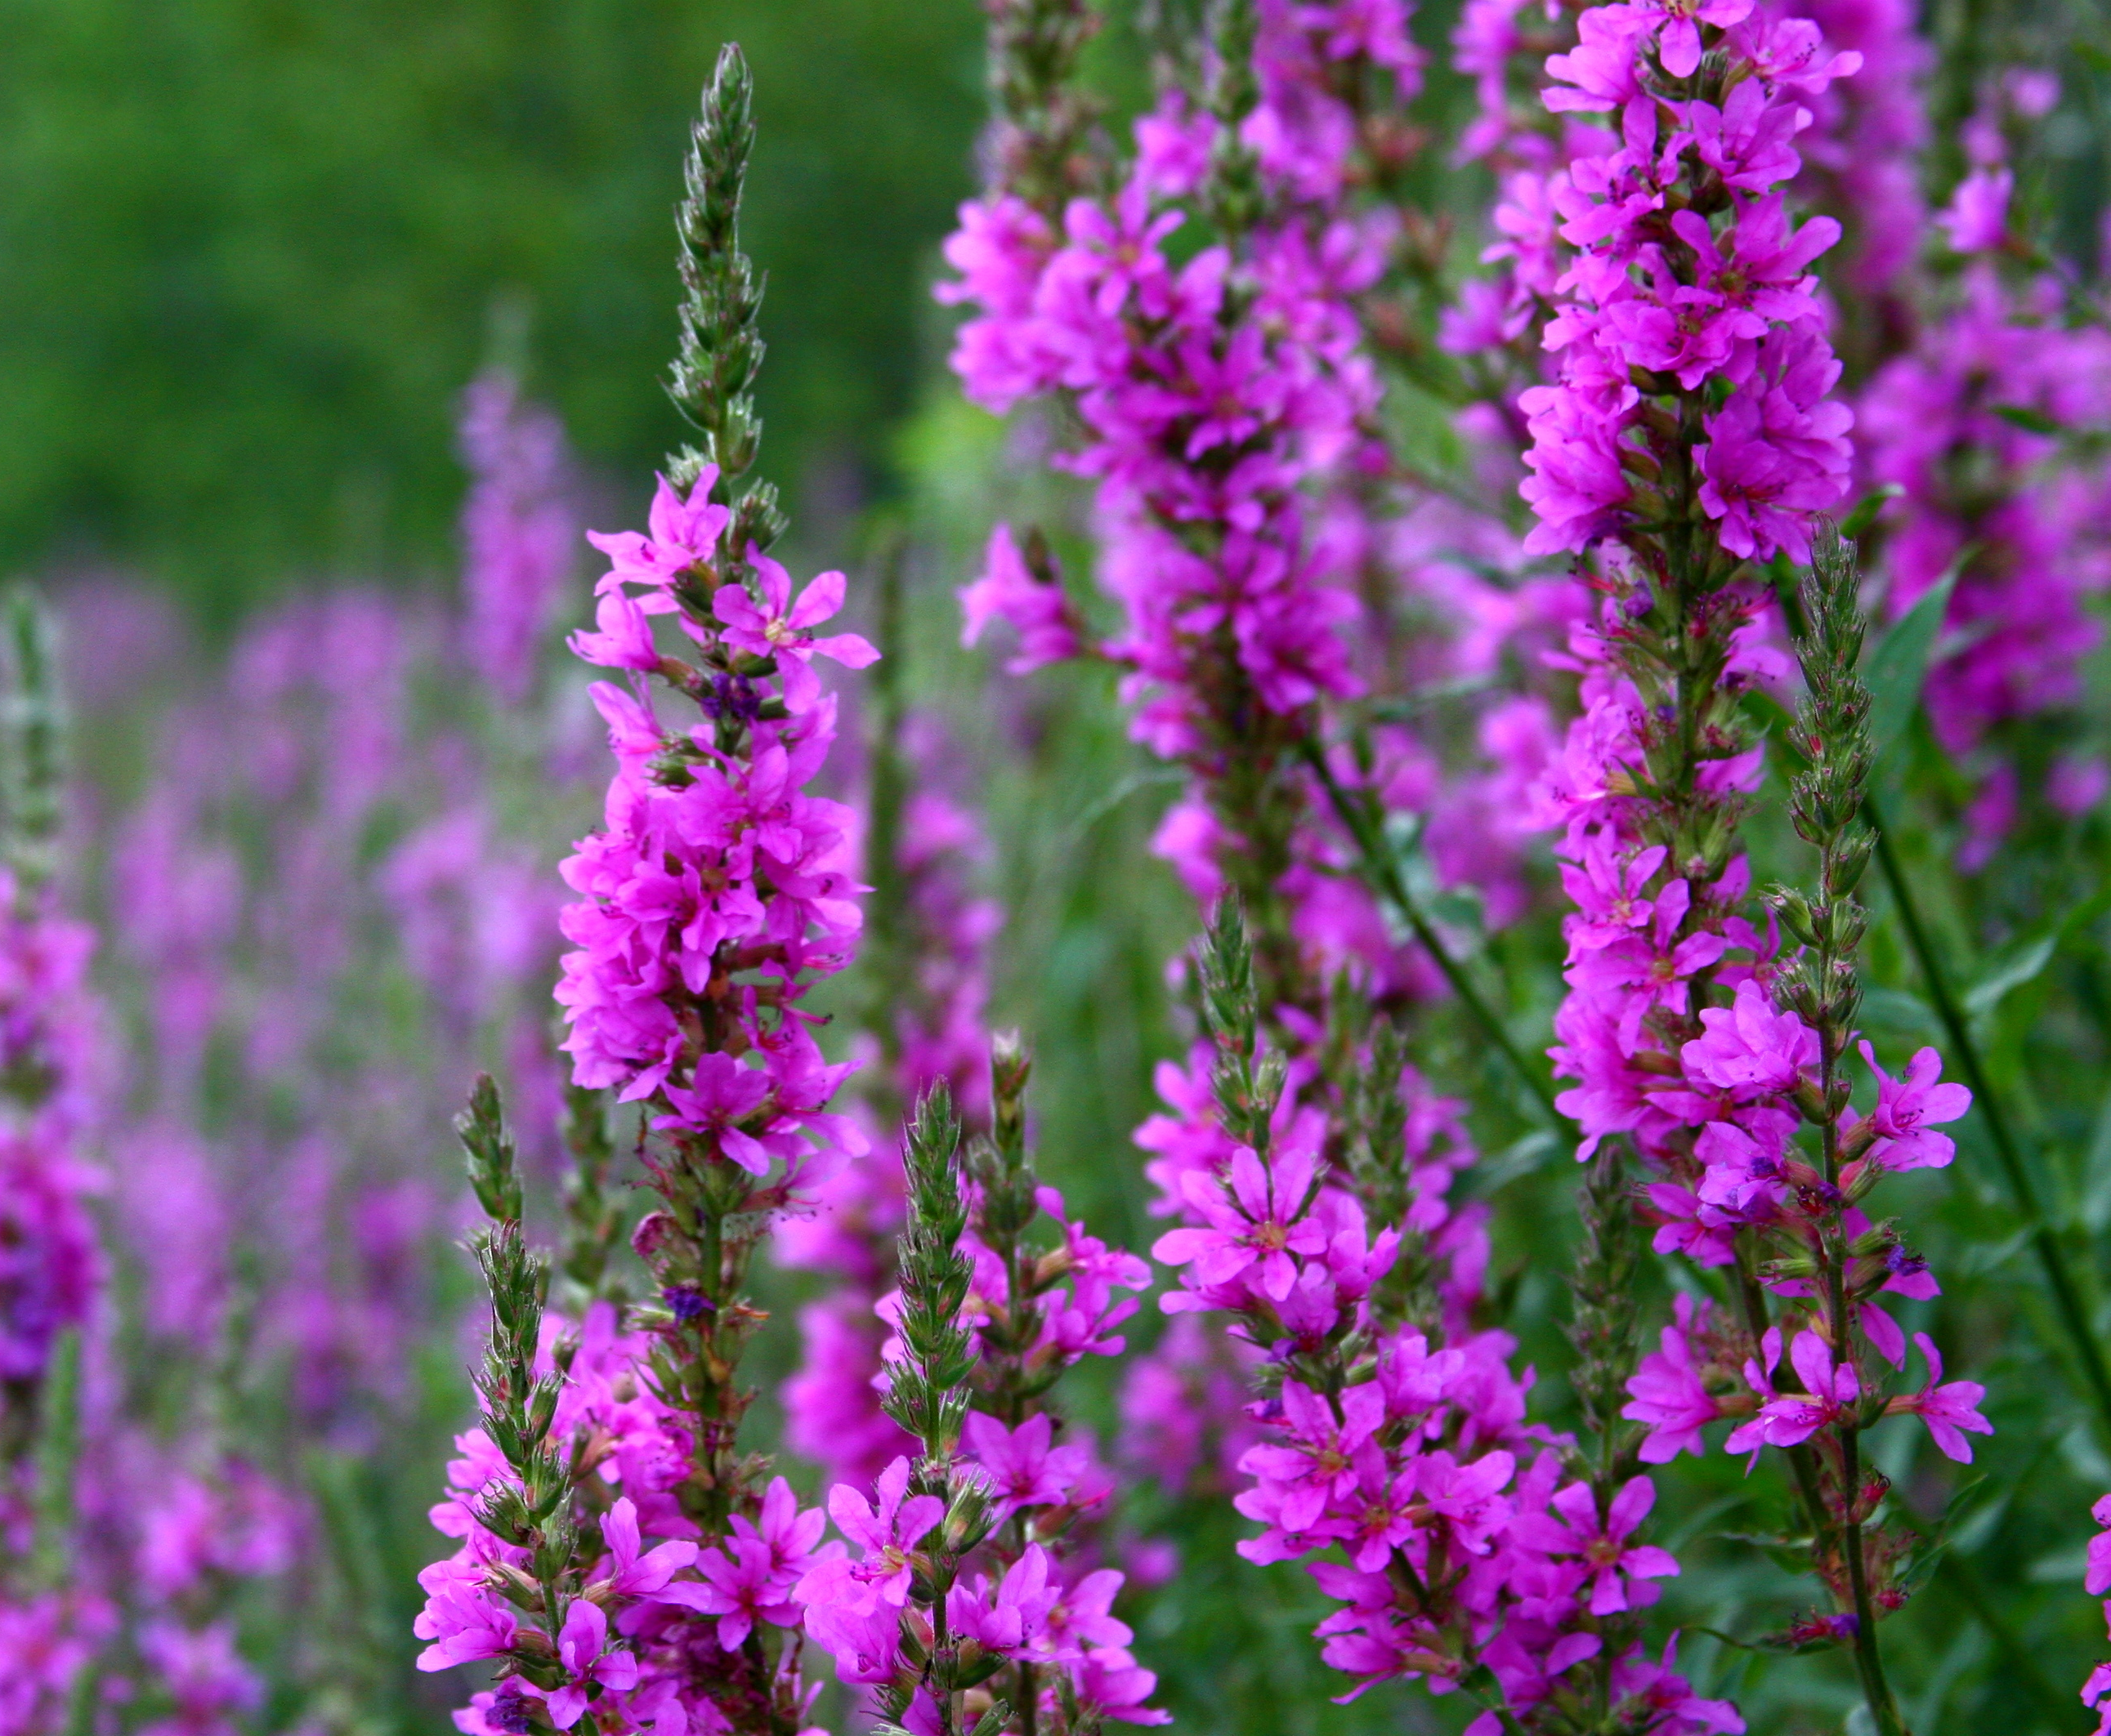
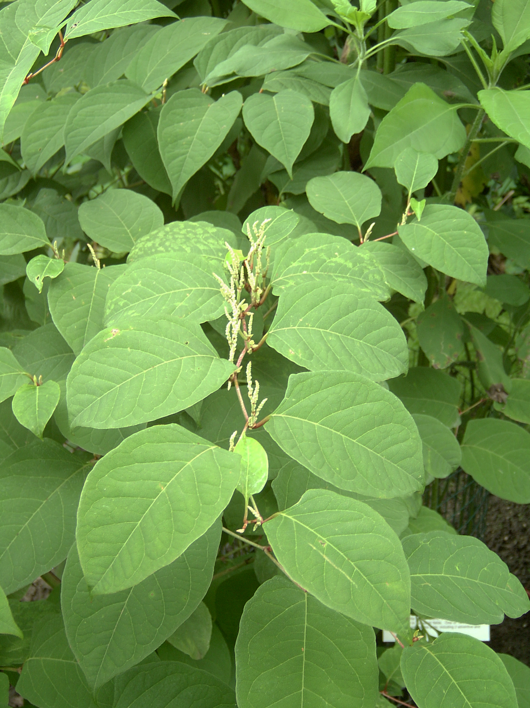
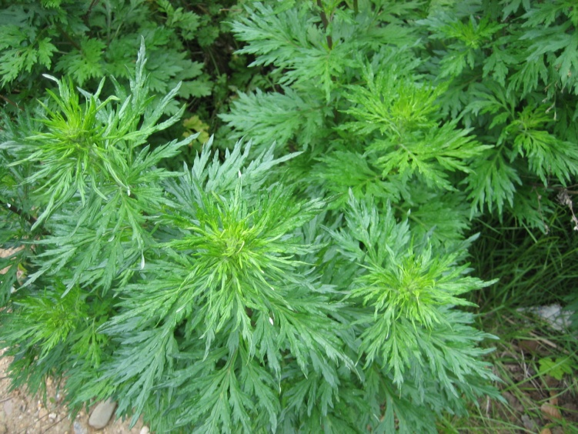
Restoring Riparian Buffers
Site Preparation
Invasive Herbaceous Perennials
Purple Loosestrife (Lythrum salicaria)
Photo Source: https://upload.wikimedia.org/wikipedia/commons/7/78/Lythrum_salicaria,_Acton,_Massachusetts.jpg
Mugwort (Artemisia vulgaris)
Japanese Knotweed (Polygonum cuspidatum)
Photo Source: http://www.pestid.msu.edu/wp-content/uploads/2014/12/Japanese-knotweed-foliage-and-flowers.jpg
Photo Source: https://upload.wikimedia.org/wikipedia/commons/9/9d/Beifuss.JPG
Notes:
It is important to understand the growth habit of the target invasive species, such as when the plant begins to grow in the spring, how it reproduces (such as by seeds or runners), and when reproduction typically happens (for example, early or late spring).
Japanese knotweed, for example (shown on the left), usually starts growing in early spring, can reach 10’ tall by summer, and dies back to the ground with the first hard frost. It has an extensive root system that can spread 20 feet from the parent plant and 7 feet deep. Root and stem fragments will sprout in moist soil and can form new plant colonies from pieces as small as ½”. Manual or mechanical control is effective only for very small patches. The stems must be cut at least twice a month during the growing season, and the whole root must be dug up. This must be done for at least 3 consecutive years. Larger invasion will require herbicide application.
Ideally, control methods will not only remove existing plants, but prevent new plants from becoming established.

Slide 20
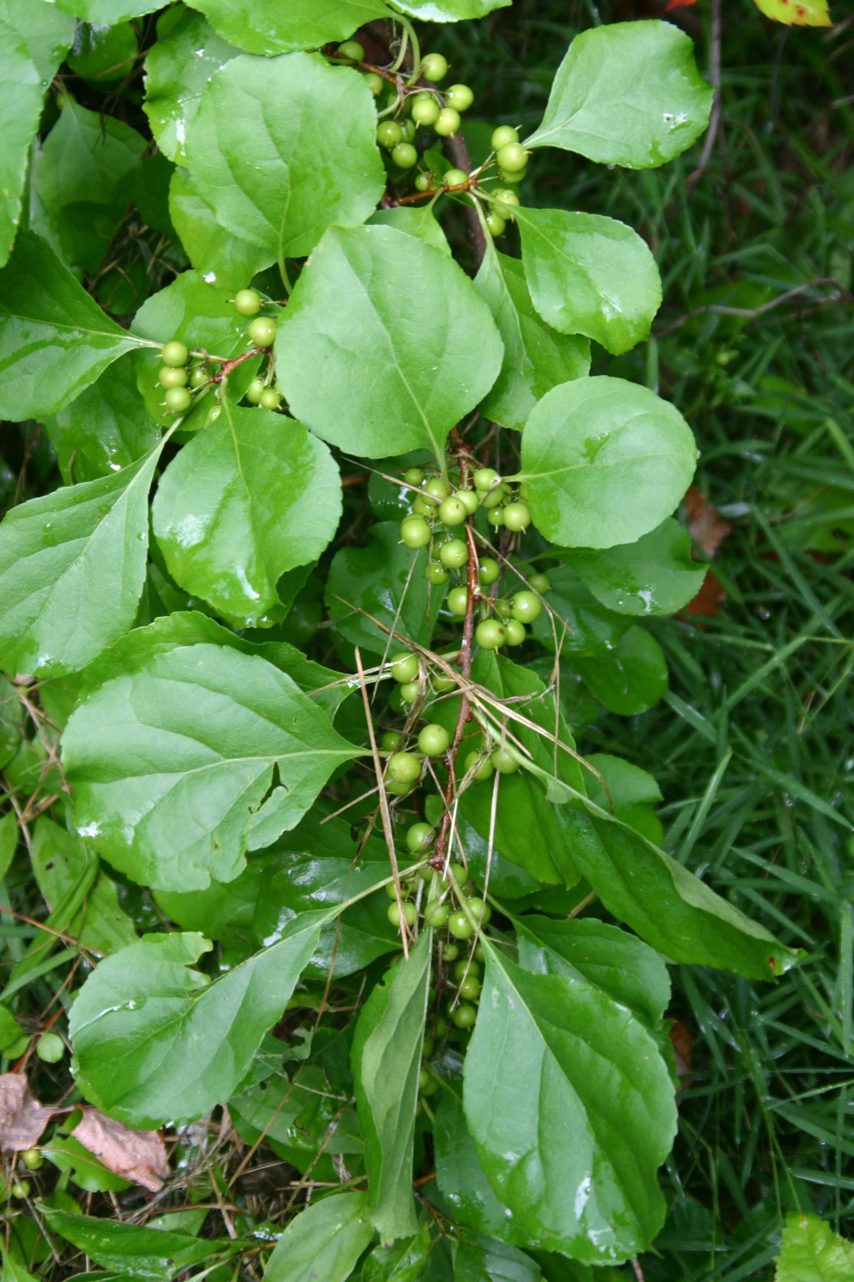
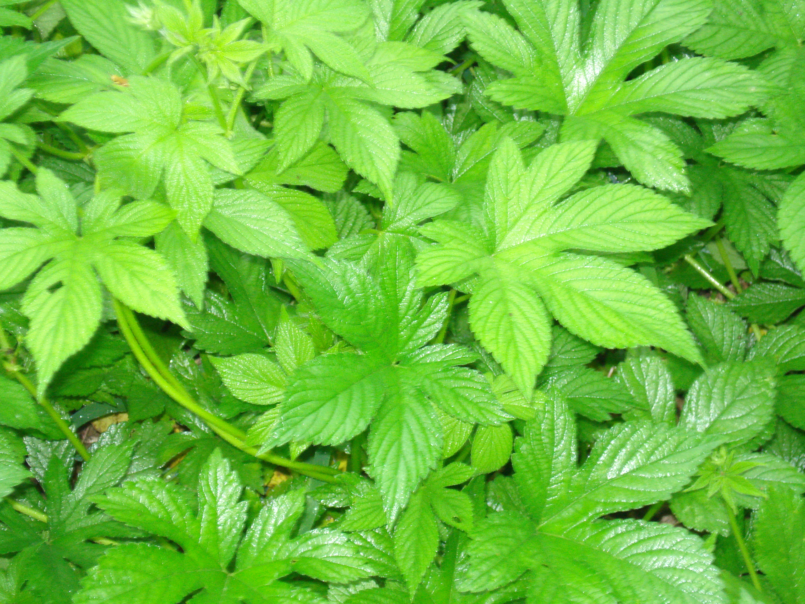
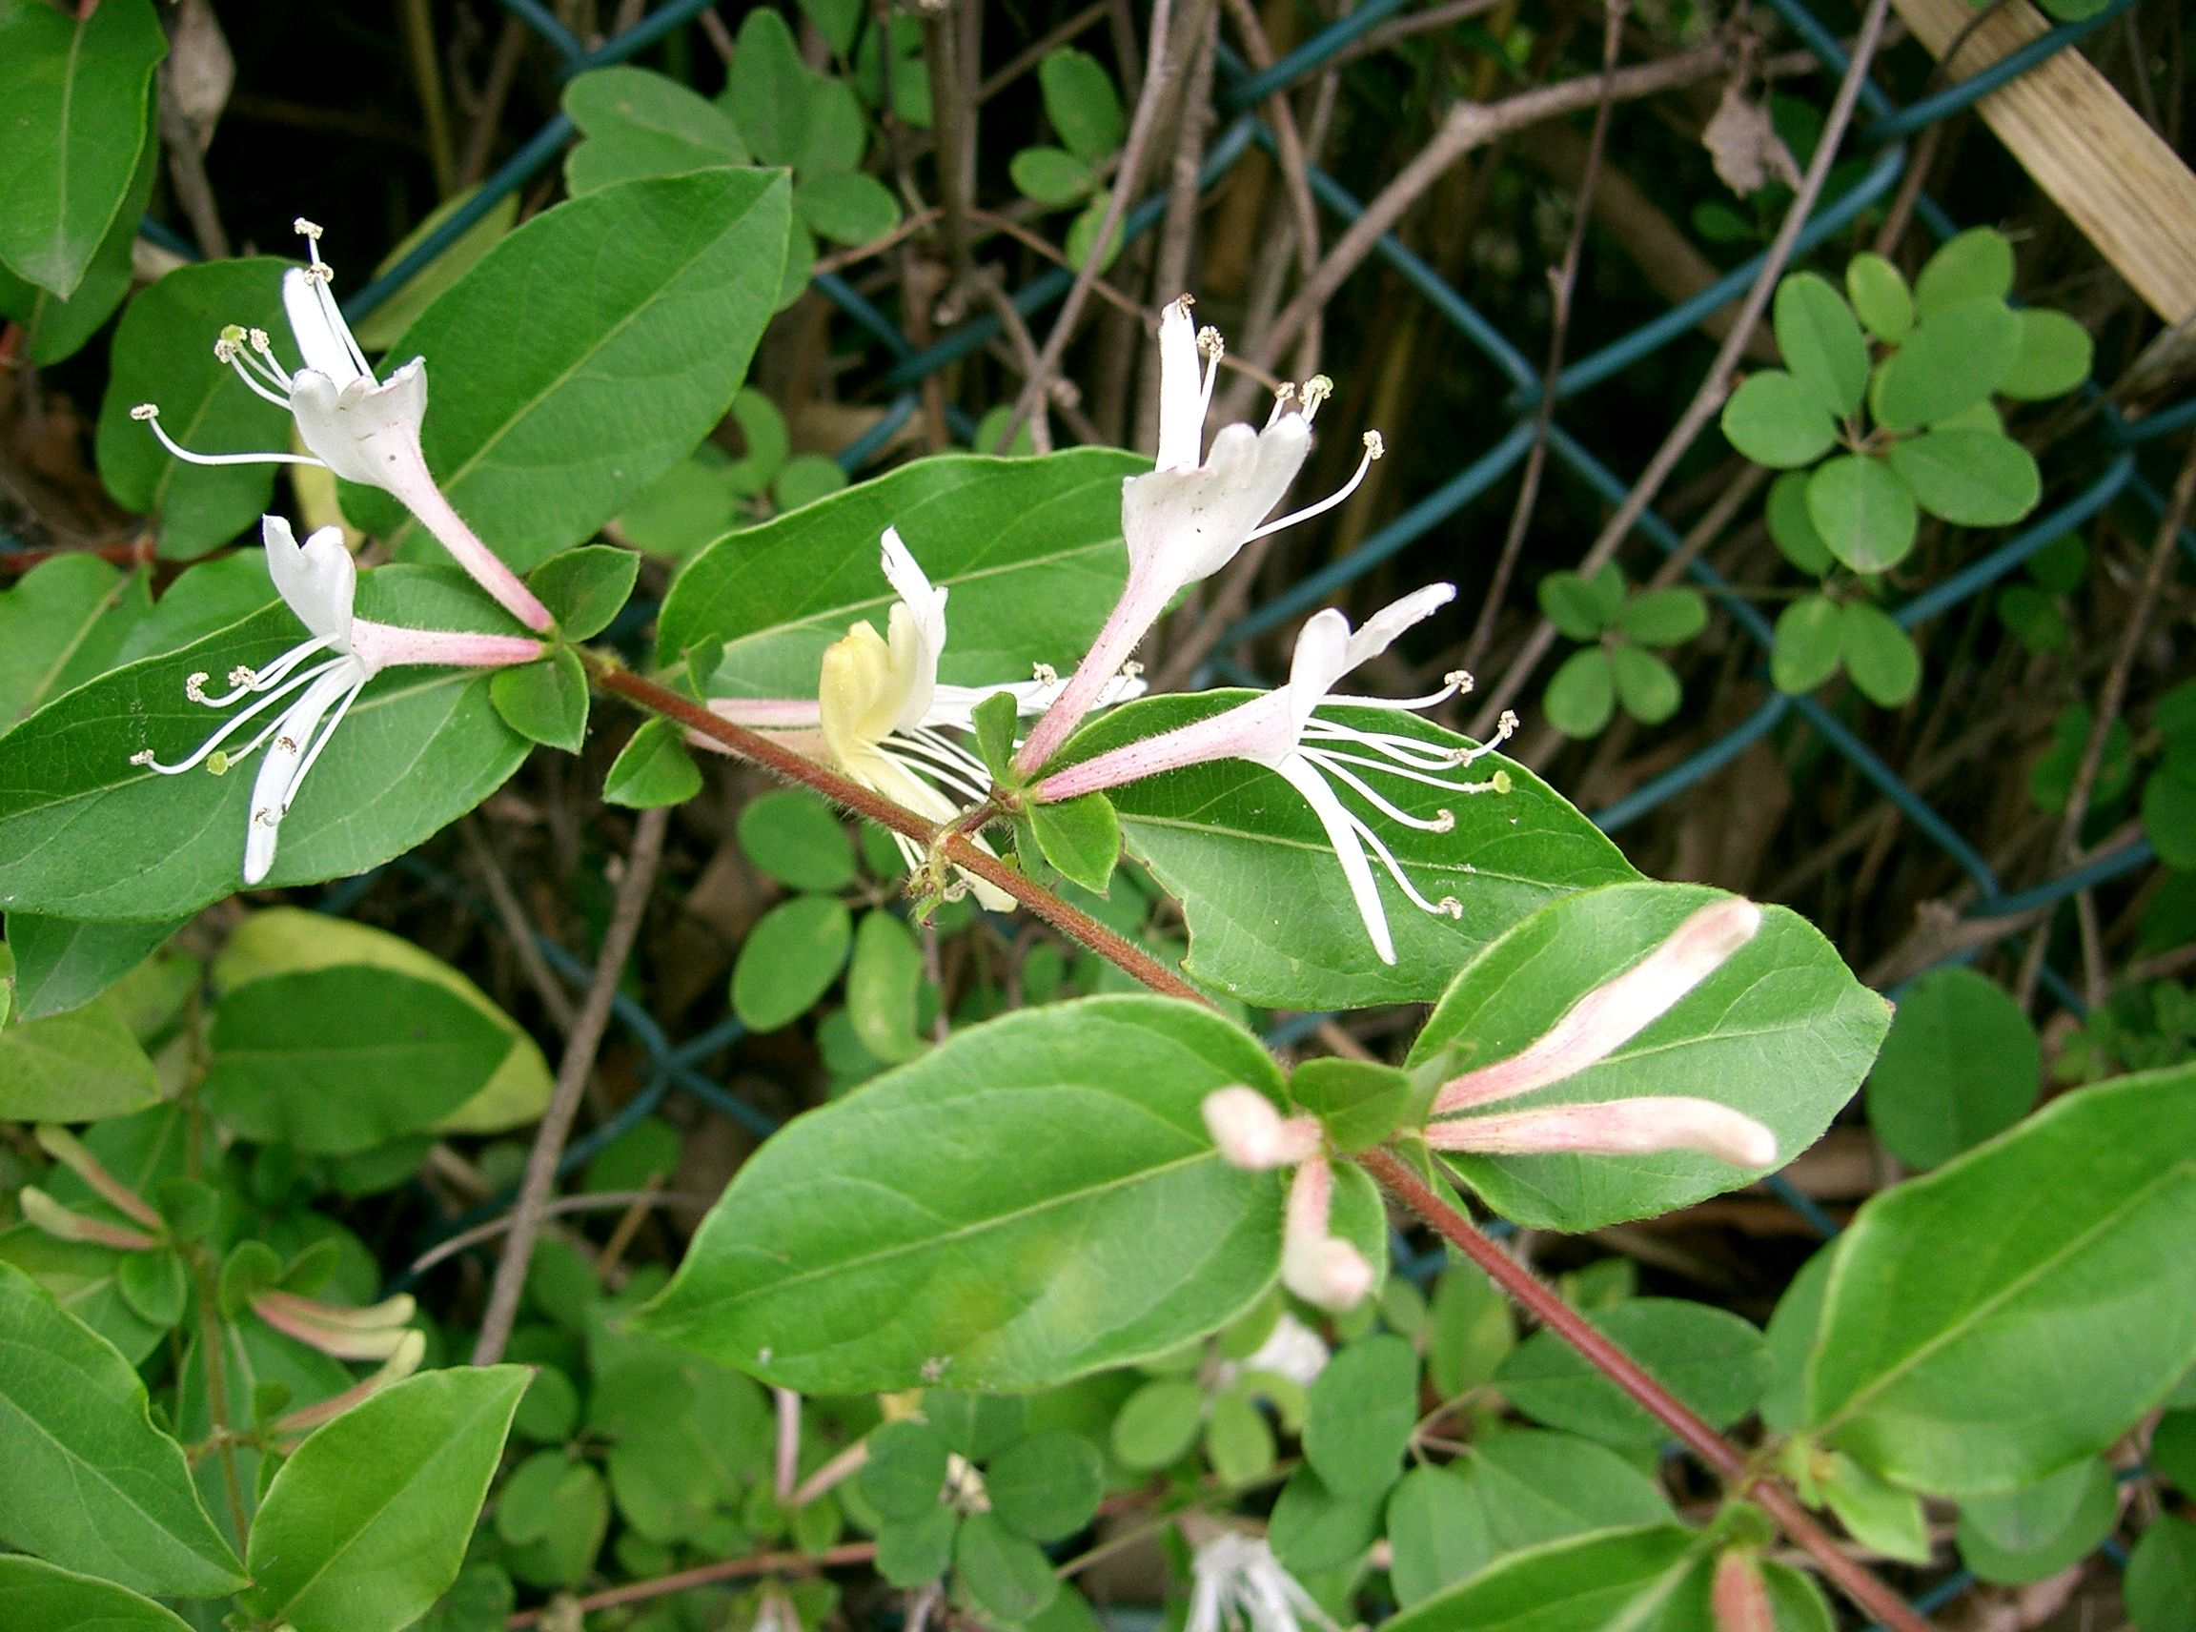
Restoring Riparian Buffers
Site Preparation
Invasive Vines
Japanese Hops (Humulus japonicus)
Photo Source: https://www.eddmaps.org/report/images/DSC02658.jpg
Oriental Bittersweet (Celastrus orbiculatus
Photo Source: https://www.albanypinebush.org/wp-content/uploads/2015/07/2006KBreisch-oriental-bittersweet.jpg
Japanese honeysuckle (Lonicera japonica)
Photo Source: https://commons.wikimedia.org/wiki/File:Lonicera_japonica2.jpg
Notes:
Many riparian areas have been invaded by vines such as Oriental bittersweet, Japanese hops, and Japanese honeysuckle.
Control methods for these species include hand pulling before they flower and set seed, repeated cutting, and the use of herbicides.

Slide 21
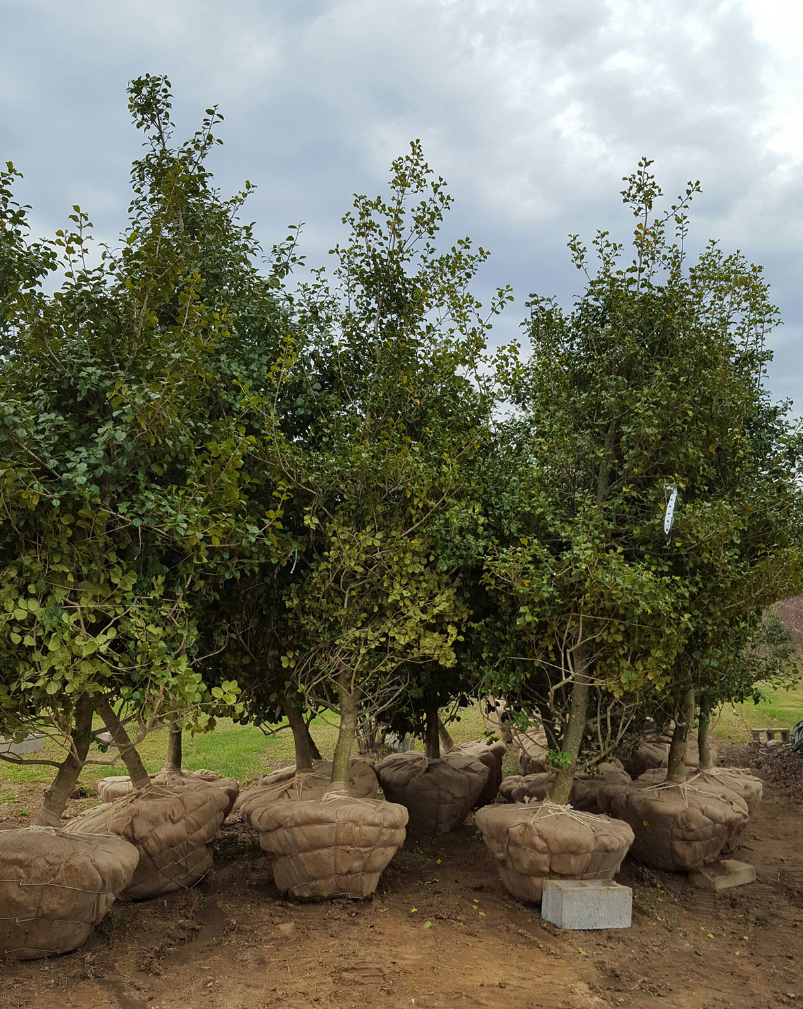
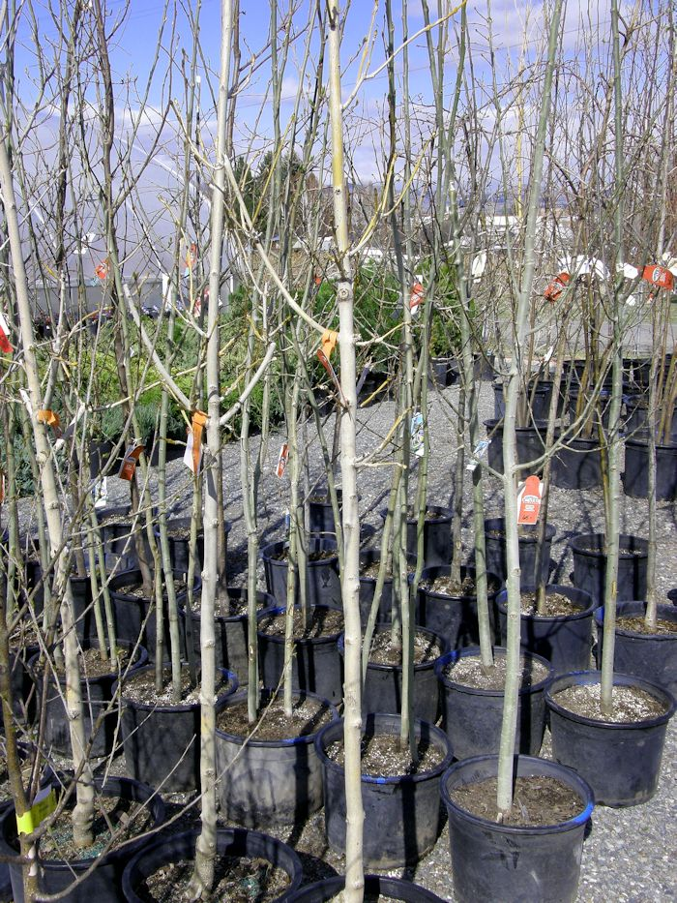
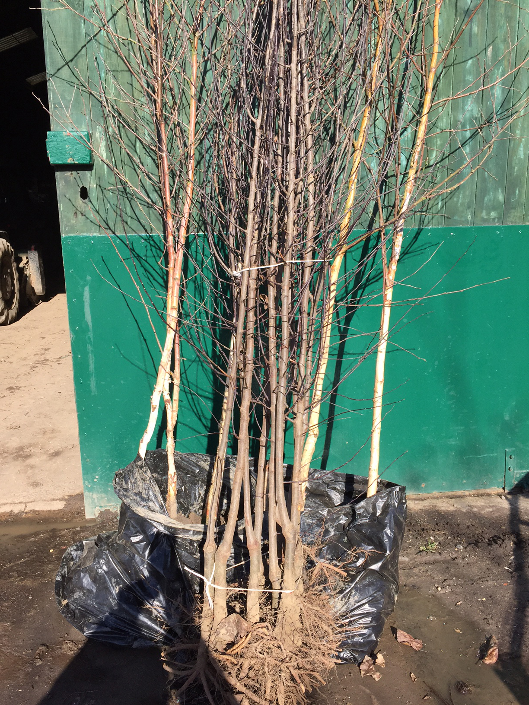
Restoring Riparian Buffers
Plant Material
Balled & Burlapped
Container
Bare Root
Notes:
When choosing plants, buy plant stock from reputable local or regional native plant nurseries to ensure plants are adapted to local conditions.
Nurseries have plants in different forms.
Balled and burlapped (or B&B) trees and shrubs are cut out of the ground and wrapped in burlap with the soil around the roots left intact. Because root-balled trees have had their roots cut at lifting, they have lost most of their fine fibrous roots. They typically grow very slowly until their roots grow back and can experience transplant shock that lasts for years. Large B&B trees are heavy and difficult to handle and are more expensive. In general, B&B stock is not the best choice for riparian restoration.
Container trees and shrubs come in various sizes depending on species and nursery. Container plants have a good success rate that enables year-round planting. The main disadvantage of container plants is that they don’t always develop a fibrous root system. Instead roots can become “pot-bound” with thick, spiraling roots that are not very efficient at water absorption and can eventually girdle the trunk.
Bare root trees are grown in the field , dug up and then the soil is washed or shaken from the roots. Usually, they can only be supplied and planted during the dormant winter months. Bare root trees are the least expensive form of nursery stock because they are lightweight, easy to plant and many can be packed in a truck to save on shipping costs. But root damage during harvest, storage and transport can lead to poor survival rates.
Planting density should be higher than the final stem density desired, to allow for losses due to competition, stress and
deer.

Slide 22
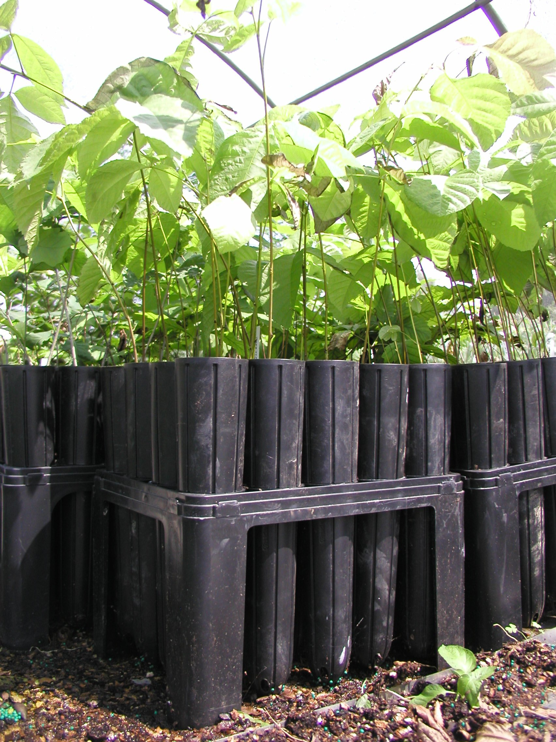
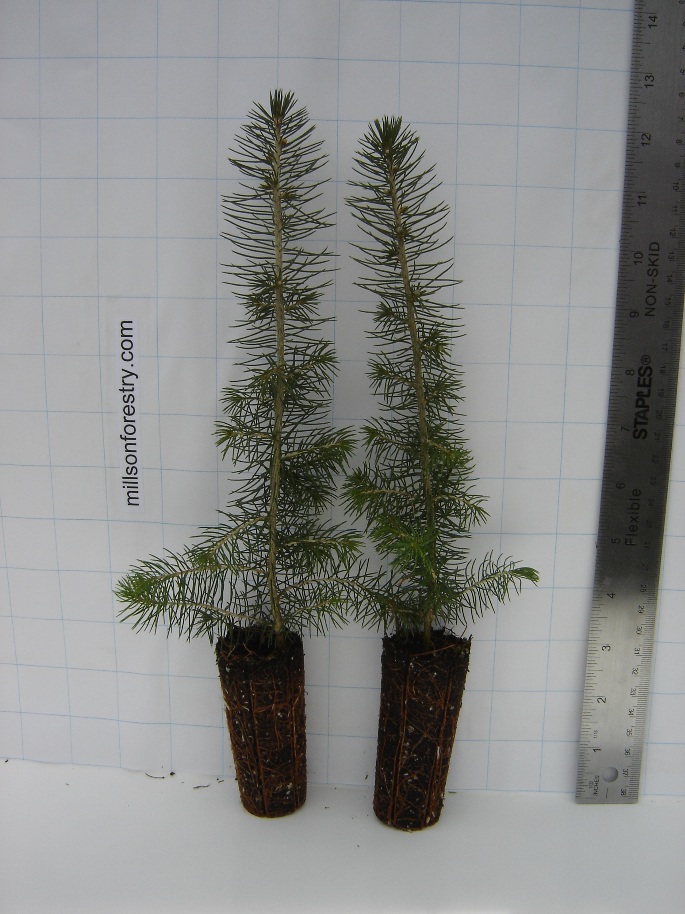
Restoring Riparian Buffers
Plant Material
Photo Source: http://www.gonativetrees.com/Small%20Shellbarks.jpg
Photo Source: http://www.millsonforestry.com/shop/images/0805%20068.jpg
Tree Seedlings
Notes:
Seedlings are very young trees that can be purchased as container grown or bare root.
Seedlings are much less expensive than larger stock depending on the source and type of plant. However, depending upon plant condition, species, and site stresses, the survival rates for seedlings range from less than 30 percent to over 90 percent. More control of competing vegetation is needed over several years to increase the survival rate of the seedlings.
Tree shelters can accelerate growth and increase the survivability of seedlings but add to the installation costs.

Slide 23
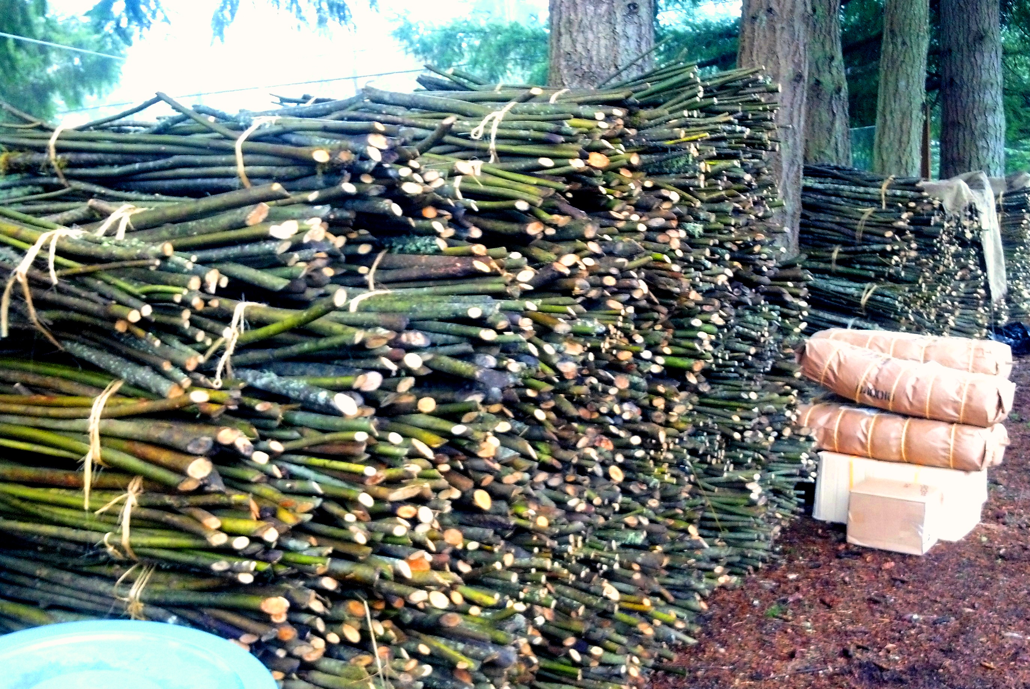
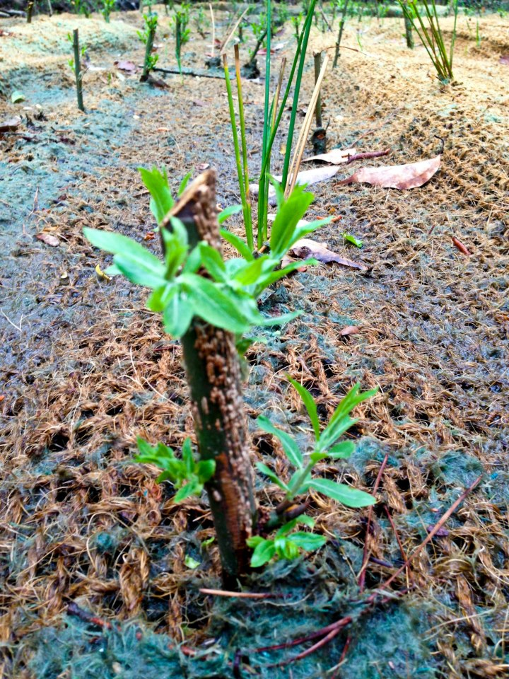
Restoring Riparian Buffers
Plant Material
Photo Source: http://www.mobilebaynep.com/assets/photos/456/13_live_stakes_become_willow_trees.jpg
Live Stakes
Photo Source: Northwest Certified Foresty, http://hosted-p0.vresp.com/1319049/bfaa2a6351/ARCHIVE
Notes:
Live stakes are a very inexpensive way to create new plants from existing plants. Shrub species such as red-osier and silky dogwoods and willows will readily root from a cutting taken from the parent plant. These stakes can be directly planted in the streambank itself without having to dig a planting hole.
Live stakes can be harvested on site or purchased from many native plant nurseries.

Slide 24
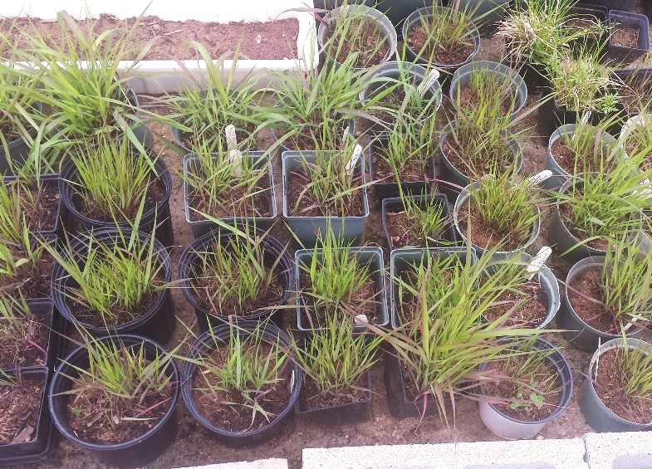
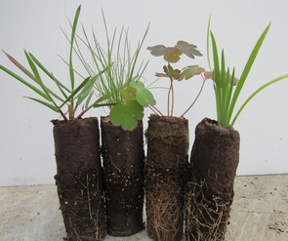
Restoring Riparian Buffers
Plant Material
Containers (quarts, gallons)
Plugs
https://arlingtonva.s3.amazonaws.com/wp-content/uploads/sites/13/2016/04/Virginia-Wild-Rye-.jpg
http://www.prairieflora.com/uploads/4/4/5/2/44520027/9100733.jpg?330
Notes:
Herbaceous plants like grasses, wildflowers, and ferns are available in different size containers or in trays of plugs, which are small seedlings in a “plug” of planting media.
Larger plants give faster coverage and fewer are needed, but are more expensive. Plugs can be cost effective, but they are less able to tolerate dry or droughty conditions than container plants, which have more developed roots systems. Proper installation at the right time is essential, and irrigation may be needed to ensure the plugs survive and become established.
As with bare root trees, plugs are often planted at higher densities to allow for some loss.

Slide 25
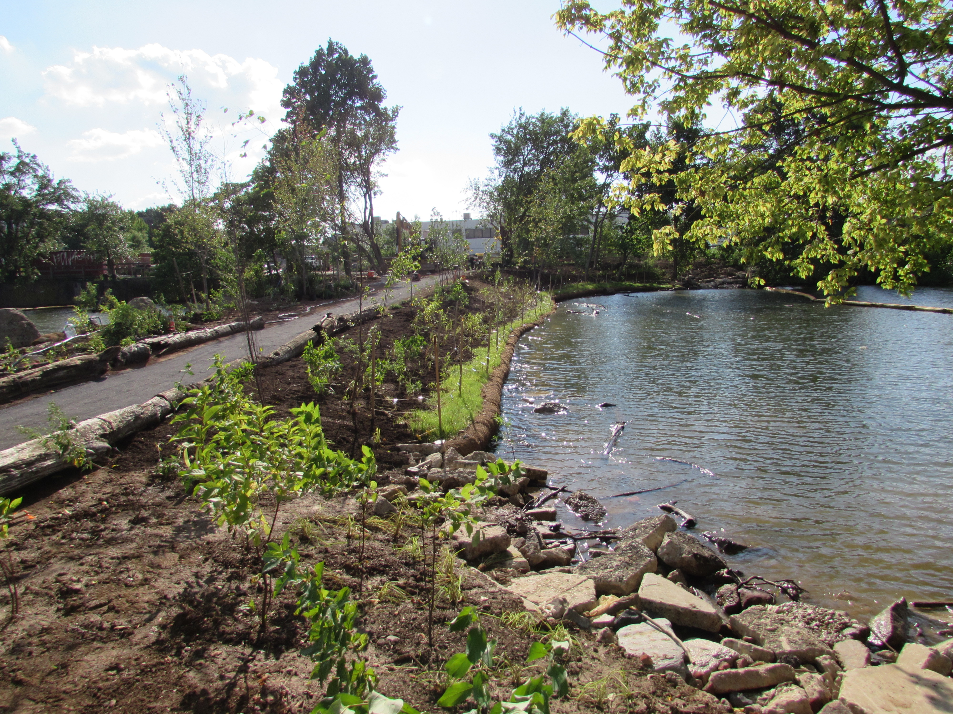
Restoring Riparian Buffers
When to Plant
Photo Source: T. Cohen, 2014
Notes:
Bare root material, seedlings and live stakes should be planted in the winter to early spring while they are still dormant.
Container and B&B trees and shrubs can be planted during early spring or fall. Planting in the spring ensures the longest season for root growth and gives the plant a chance to establish feeder roots before the moisture demands of the growing season.
Most deciduous trees and shrubs can be planted later in the fall after leaf drop, since their roots will continue to grow until the soil temperature falls below 45 degrees. However, the ground must have adequate moisture, or a severe winter will kill the trees. There are some species that do not transplant well in the fall (e.g., birch, magnolia, poplar, redbud).
Evergreens can be planted in early spring after soil temperatures warm up and while there is adequate soil moisture in the root zone. In the fall, evergreens can be planted after the heat and drought of summer have passed, but before soil temperatures drop and soil moisture to roots becomes limited.
Summer planting is possible if plants are kept well-watered, particularly if the plants were dug from the nursery in the spring or grown in containers.

Slide 26
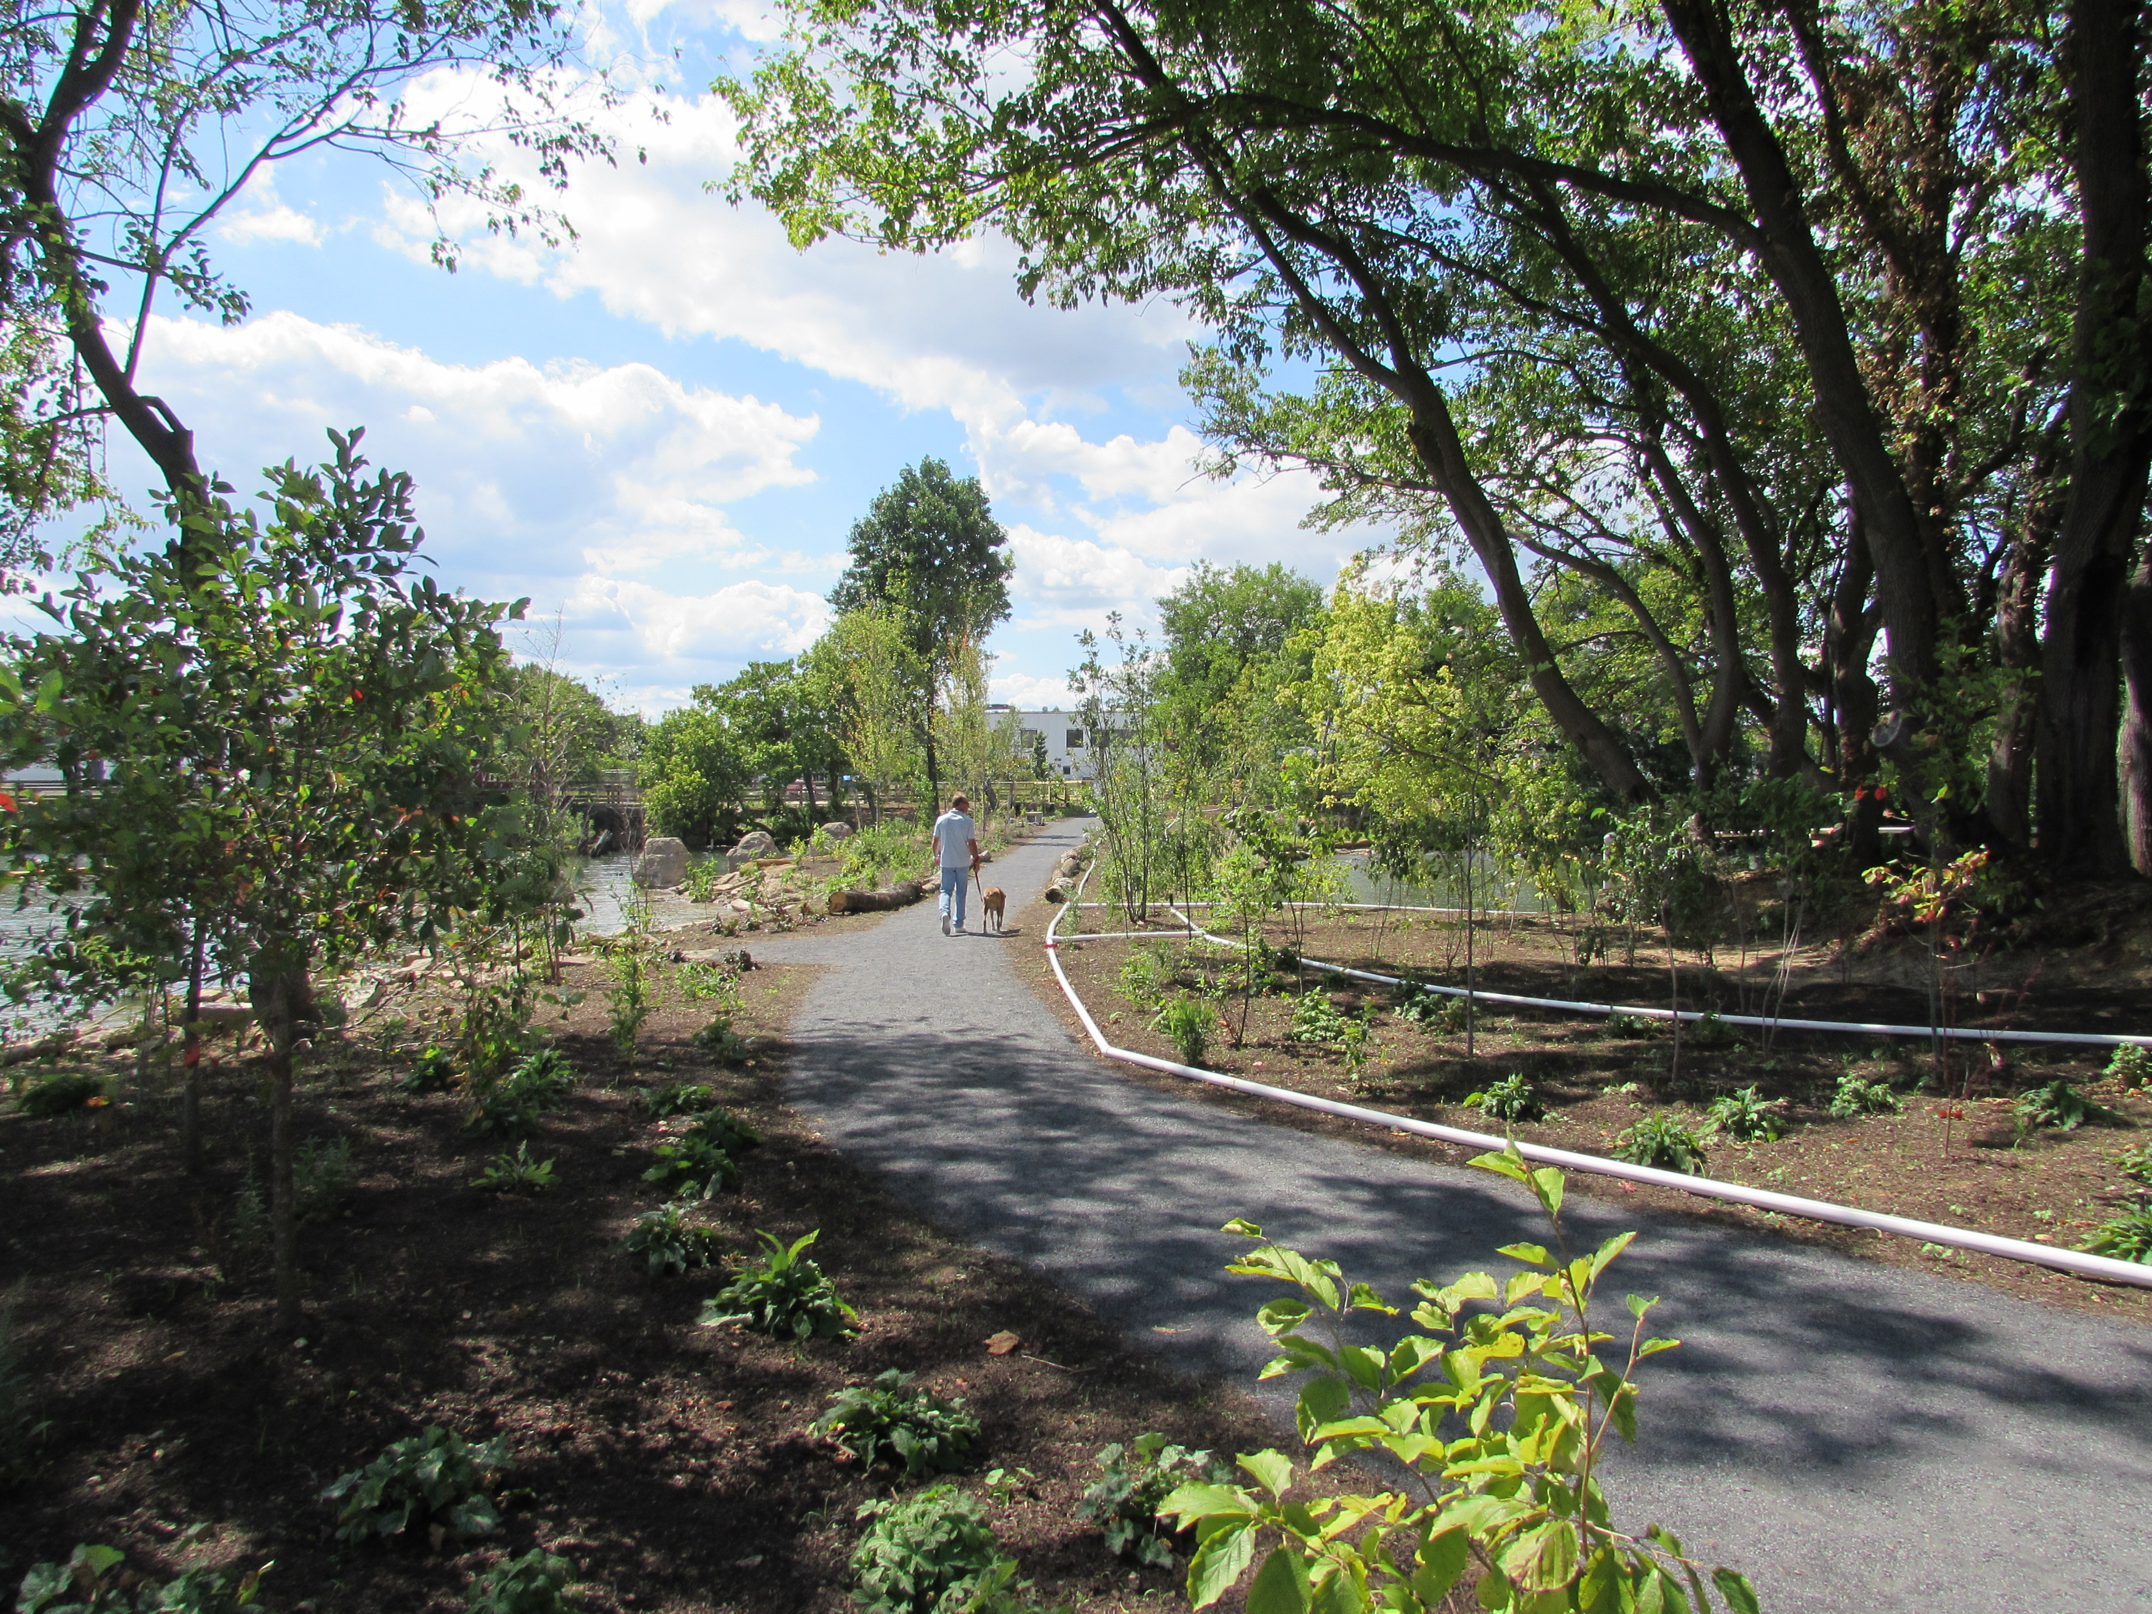
Restoring Riparian Buffers
Watering
Photo Source: T. Cohen, 2014
Notes:
Regular maintenance should begin immediately after the buffer has been planted.
During the first 3-5 years, a number of activities are needed to ensure successful establishment of the buffer.
Deep, regular watering through the first growing season is important for new plants. If watering is difficult or not possible, then planting should correspond to seasonal rains. On this site, because planting had to be done in August, an irrigation line was installed and new plantings were watered from the river.

Slide 27
Restoring Riparian Buffers
Mulch
Photo Source: T. Cohen, 2014
Notes:
New plants should receive organic mulch at installation to help retain soil moisture, moderate soil temperature, and suppress weeds. Use 2 to 4 inches of well-aged, coarse shredded bark, compost, or leaf mold. Make sure the mulch is not contaminated with weed seeds or parts of invasive species that can sprout. During the establishment period, mulch may need to be replenished but should never exceed 4 inches.

Slide 28
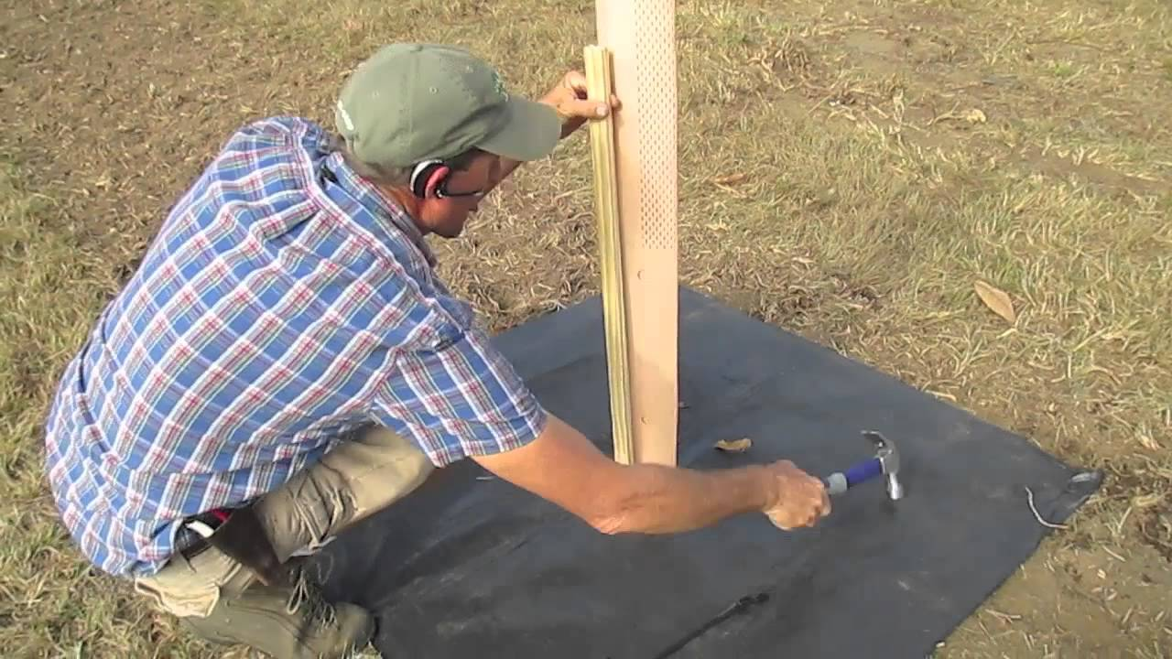
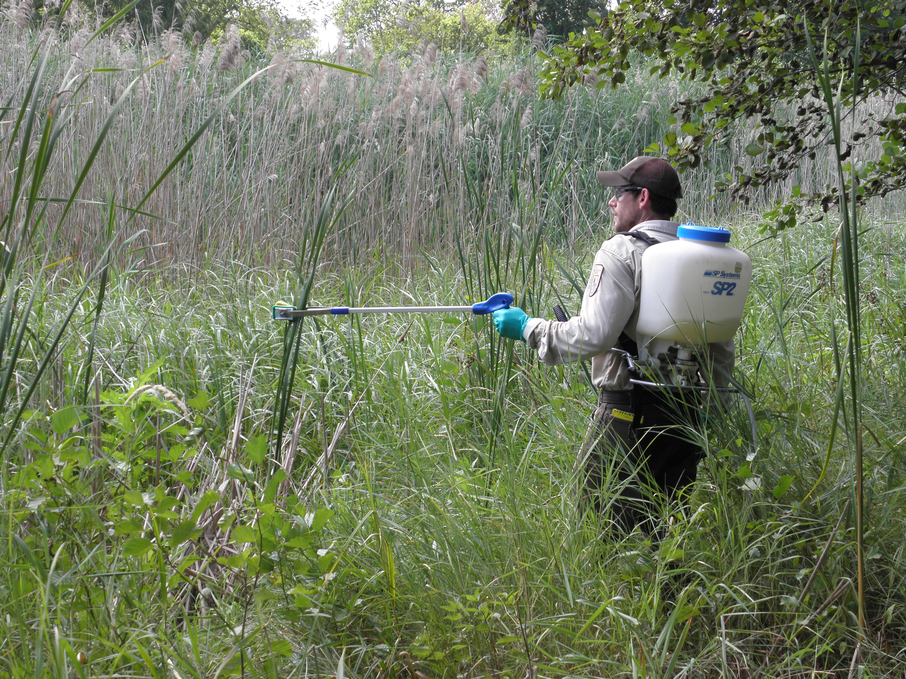
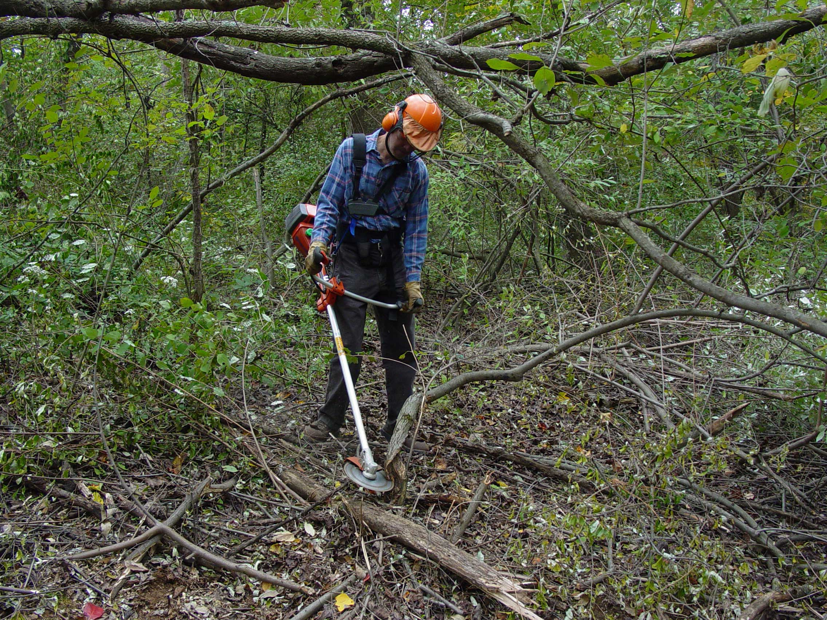
Restoring Riparian Buffers
Weeds & Invasive Species Control
Photo Source: http://www.chestnuthilltreefarm.com/store/pg/43-How-to-Plant-and-Grow-1.aspx
Photo Source: https://www.fws.gov/refuge/detroit_river/what_we_do/resource_management.html
Photo Source: http://www.inwoodlands.org/invasive-vegetation-control/
Notes:
Competition from weeds and invasive species can limit buffer growth and survival.
Hand and mechanical removal depends on size of the site, available workforce, type of plant. Brush saws can be used to safely and efficiently clear infestations of large invasive brush species. Applying an appropriate herbicide to the cut stump shortly after cutting will prevent sprouting.
Mowing or string trimming should be done twice during the growing season; in the spring before weeds are higher than 18 inches and in summer before seed production. Mower height should be 8 to 12 inches to limit the cutting of slow-growing native plants.
Weed mats, which are synthetic fabric sold in sheets or rolls, suppress the growth of plants around the base of the tree. They should be removed when trees have a large enough canopy to shade out weeds.
Herbicides can be used selectively for specific problem plants.

Slide 29
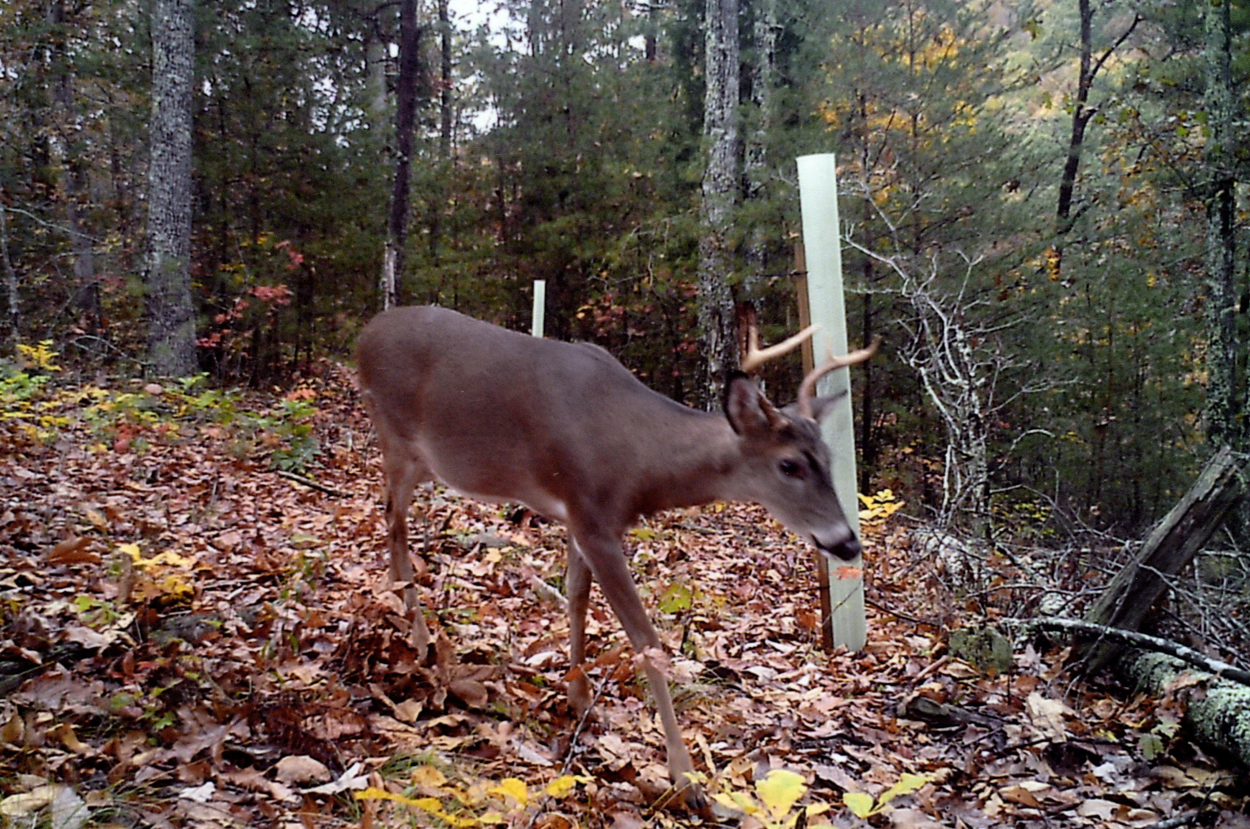
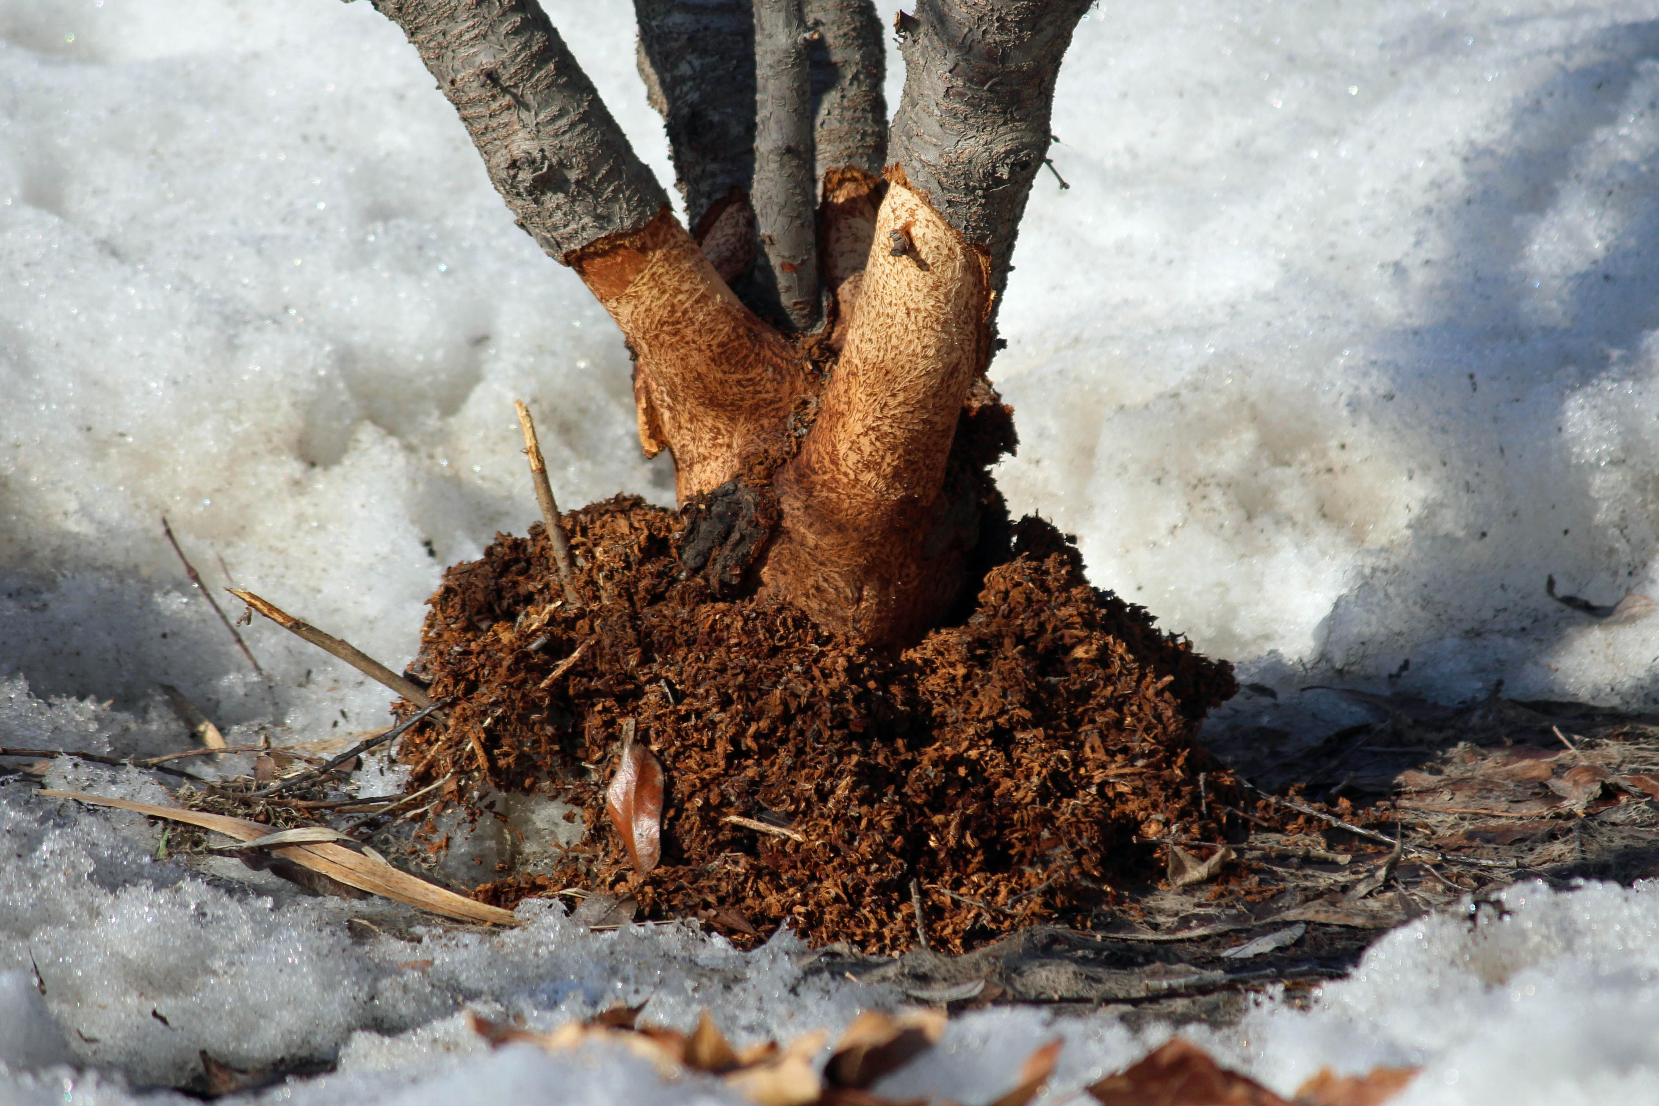
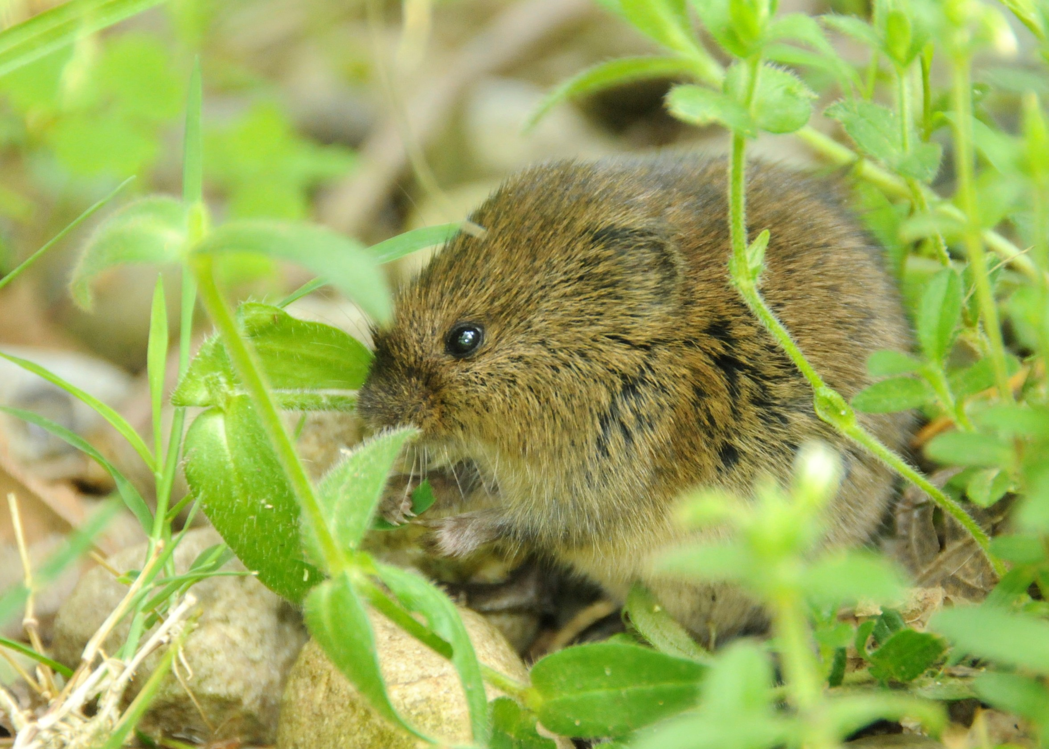
Restoring Riparian Buffers
Deer Protection
Photo Source: https://heatherv11.files.wordpress.com/2014/04/vole-damage3.jpg
Photo Source: http://02b93fb.netsolhost.com/blog/wp-content/uploads/2012/05/MeadowVole.Ashland.5.15.12.derekstoner-615.jpg
Photo Source: http://wilsonforsup.com/products/tree-tubes
Notes:
In areas with high deer populations, deer can severely damage or kill newly planted or developing riparian buffers.
When planning a buffer project, look for signs of high deer density, such as overgrazing in the shrub and ground layer.
Tree shelters protect young plants from deer. Shelters are placed around individual trees. They must be installed properly to keep out voles and rabbits, which can also damage plants.

Slide 30
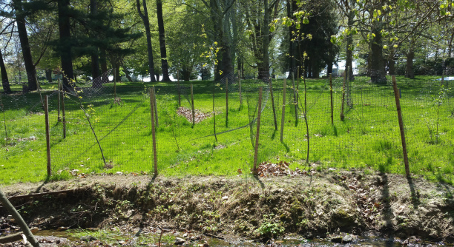
Restoring Riparian Buffers
Deer Protection
Photo Source: https://akirebubar.files.wordpress.com/2015/05/fenced-saplings-across-stream-afs.jpg?w=730&h=206
Notes:
For larger sites, deer exclusion fencing can be placed around groups of plants.

Slide 31
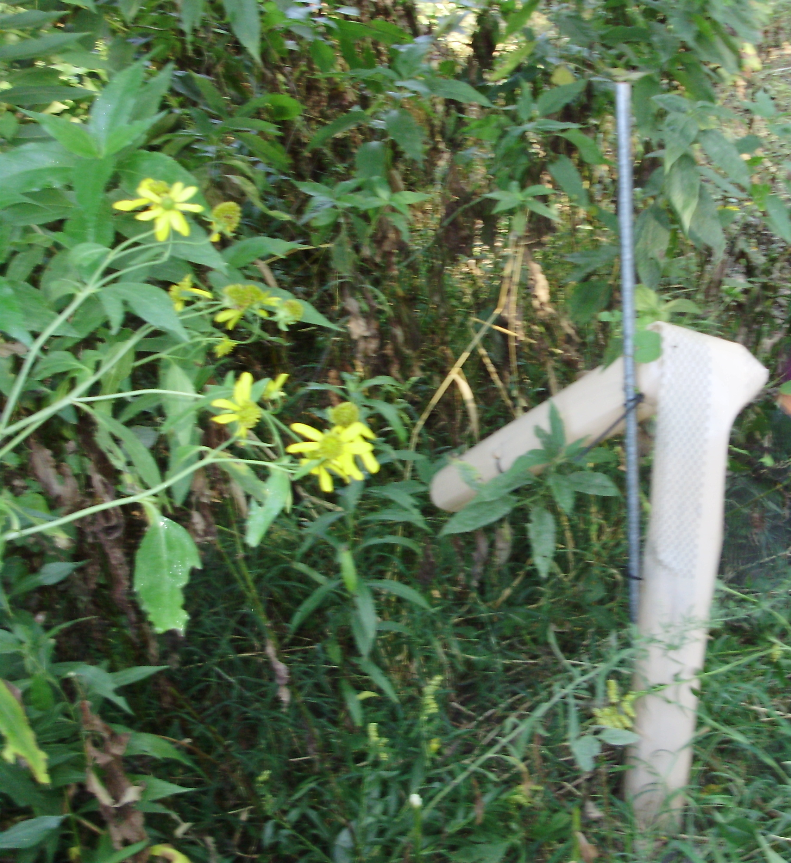
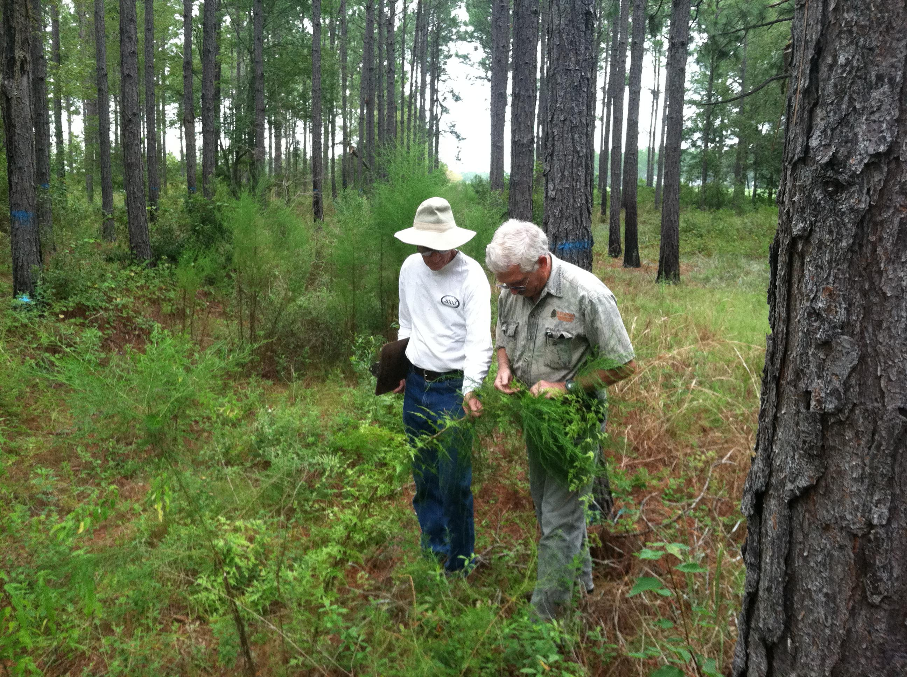
Restoring Riparian Buffers
Monitoring
A federal wildlife refuge employee using a wick applicator to apply herbicide to control invasive species
Deer-damaged tree shelter
Photo Source: https://milligansganderhillfarm.files.wordpress.com/2013/09/p4140009.jpg
Notes:
Buffers must be monitored to determine whether maintenance activities are effective and to find and correct emerging problems early.
In the first 3 – 5 years, the planting site should be monitored four times a year: late fall, late winter, late spring, and late summer.
Monitoring should be done to determine survival rates of the plants (no. of plants surviving/no. of plants installed).
Also check for
Deer and vole damage
Damage from insects
Disease
Dead and dying plants that will need to be replaced
Invasive species
Erosion
Damage to tree shelters or fencing
Vandalism

Slide 32
In This Presentation You Learned:
What Is a Riparian Forest Buffer?
The Benefits of Riparian Buffers
Loss of Riparian Buffers
Restoring and Maintaining Riparian Buffers
Photo source: htt p://www.dcnr.state.pa.us/cs/groups/public/documents/document/dcnr_20031767.jpg
Notes:
We hope you now have a better understanding of the importance of the landscape immediately next to a stream. In this presentation you learned:
What Is a Riparian Forest Buffer?
The Benefits of Riparian Buffers
Loss of Riparian Buffers
Restoring and Maintaining Riparian Buffers

Slide 33
Notes:
This concludes this presentation on riparian buffer management for green infrastructure. Thank you to our funder – the US Environmental Protection Agency Region III, and partners AKRF, Inc. and GreenTreks Network, which helped produce this series.

